Slide 1


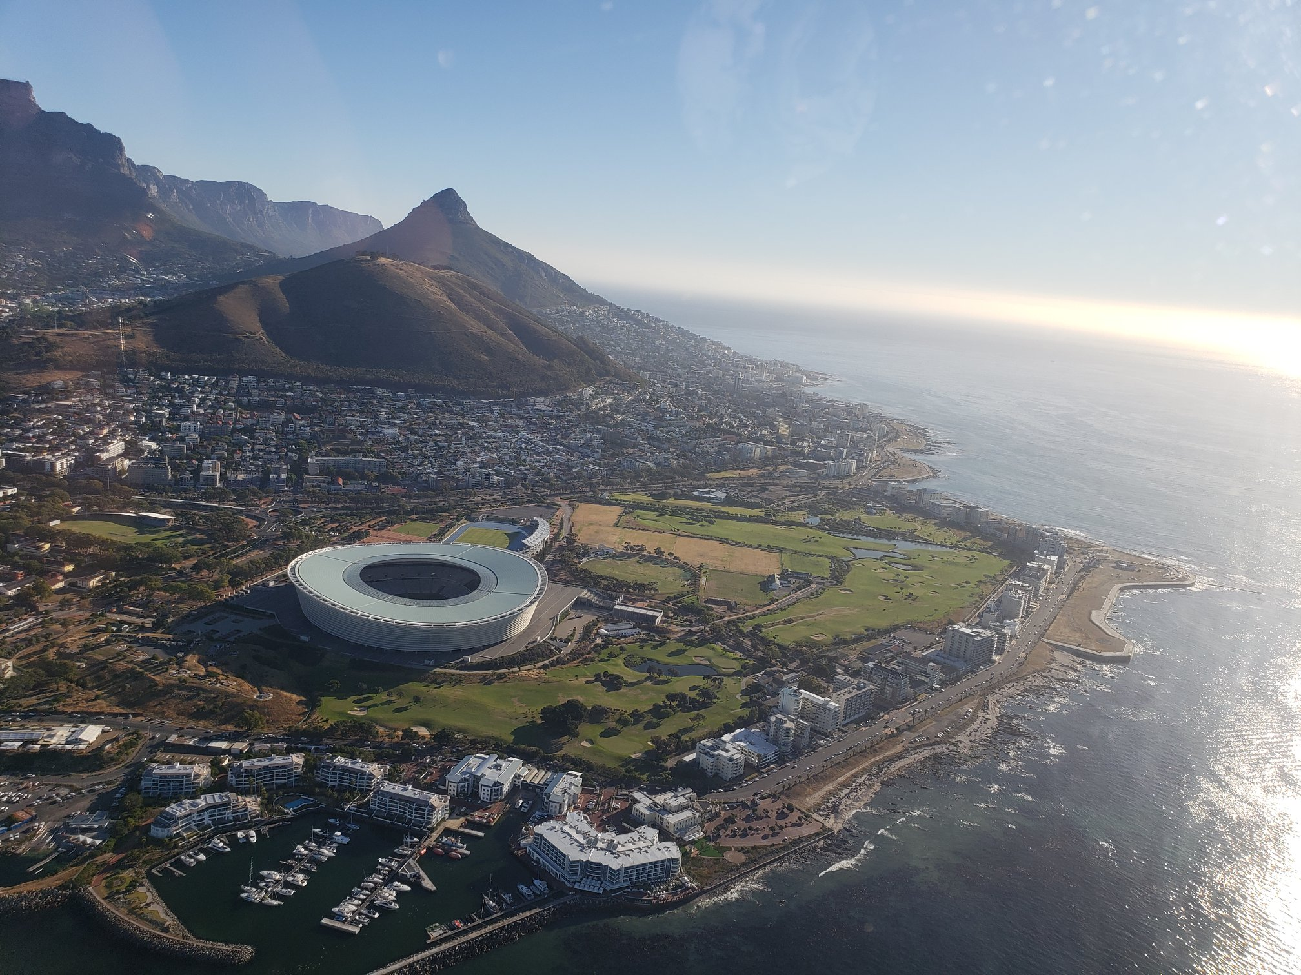



AFIRM: ACM SIGIR/SIGKDD Africa Summer School on Machine Learning for Data Mining and Search Deep Learning for Search
Instructors
Bhaskar Mitra, Microsoft & University College London, Canada
Nick Craswell, Microsoft, USA
Emine Yilmaz, University College London & Microsoft, UK
Daniel Campos, Microsoft, USA
January 2019

Slide 2


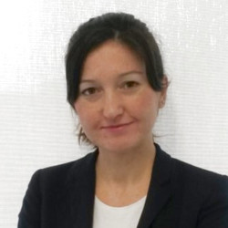



The Instructors
Bhaskar Mitra
Nick Craswell
Emine Yilmaz
Daniel Campos
Microsoft & UCL, Canada
bmitra@microsoft.com
@underdoggeek
Microsoft, USA
nickcr@microsoft.com
@nick_craswell
UCL & Microsoft, Canada
emine.yilmaz@ucl.ac.uk
@xxEmineYilmazxx
Microsoft, USA
dacamp@microsoft.com
@spacemanidol

Slide 3

Reading material
An Introduction to
Neural Information Retrieval
Foundations and Trends® in Information Retrieval
(December 2018)
Download PDF: http://bit.ly/fntir-neural
FREE COPIES

Slide 4
Agenda
Fundamentals (15 mins)
Term embeddings for IR (25 mins)
Learning to rank (20 mins)
Break (30 mins)
Deep neural networks for IR (30 mins)
Vector representations (35 mins)
Lunch (60 mins)
Deep neural networks (25 mins)

Slide 5
Fundamentals: a refresher
(15 mins)

Slide 6


neural networks
Neural Information Retrieval (or neural IR) is the application of shallow or deep neural networks to IR tasks.
IR

Slide 7

Information Retrieval (IR)
User has an information need
There exists a collection of information resources
IR is the activity of retrieving the information resources relevant to the information need

Slide 8


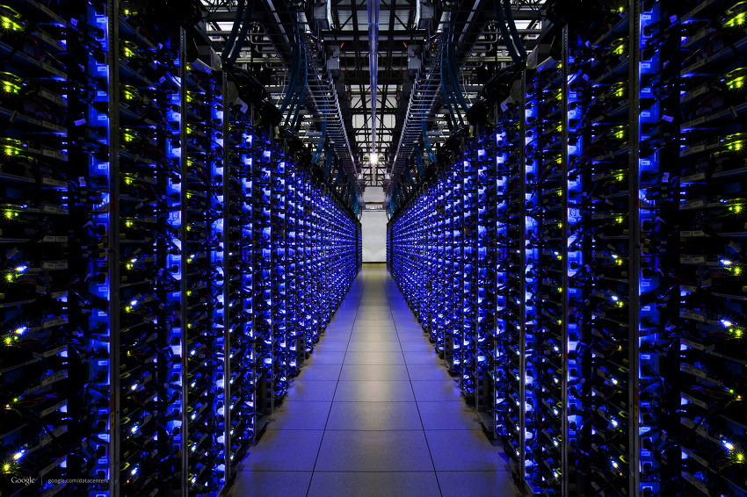
Example of an IR task (Web search)
Information need
Relevance (documents satisfy information need)
User expresses information need as a short textual query
The search engine retrieves top relevant web documents as information resources
We will use web search as the main example of an IR task in the rest of this lecture
results ranking (document list)
query
retrieval system indexes a document corpus

Slide 9
Desiderata
Decades of IR research has identified some key factors that text retrieval models should consider
Traditional IR models typically incorporate one of more of these
Term frequency
Term weighting
Term saturation
Document length
Term proximity
Term position
Vocabulary mismatch
Term aboutness

Slide 10
Desiderata
Term frequency
Term weighting
Term saturation
Document length
Term proximity
Term position
Vocabulary mismatch
Term aboutness
preferable over
A document that contains more occurrences of the query term(s) is more likely to be relevant
Tip: consider term frequency (TF)

Slide 11
Desiderata
Term frequency
Term weighting
Term saturation
Document length
Term proximity
Term position
Vocabulary mismatch
Term aboutness
more informative than
A rare term (e.g., “msmarco”) is likely to be more informative than a common term (e.g., “and”)
Tip: consider inverse document frequency (IDF)

Slide 12
Desiderata
Term frequency
Term weighting
Term saturation
Document length
Term proximity
Term position
Vocabulary mismatch
Term aboutness
preferable over
A term should not contribute disproportionately
Increase in TF should have larger impact for smaller TFs
Tip: put a saturation function over the TF

Slide 13

Desiderata
Term frequency
Term weighting
Term saturation
Document length
Term proximity
Term position
Vocabulary mismatch
Term aboutness
preferable over
A document containing more non-relevant terms is likely to be less relevant
Tip: perform document length normalization

Slide 14
Desiderata
Term frequency
Term weighting
Term saturation
Document length
Term proximity
Term position
Vocabulary mismatch
Term aboutness
preferable over
A document containing query terms in close proximity is likely to be more relevant than one where the terms occur far away from each other
Tip: consider proximity features

Slide 15
Desiderata
Term frequency
Term weighting
Term saturation
Document length
Term proximity
Term position
Vocabulary mismatch
Term aboutness
preferable over
Term matches earlier in the document may indicate more likelihood of the document being relevant
Tip: consider position of term matches

Slide 16
Desiderata
uk prime minister
Term frequency
Term weighting
Term saturation
Document length
Term proximity
Term position
Vocabulary mismatch
Term aboutness
theresa may
The query and the document may refer to the same concept using different vocabularies
Tip: consider expanding the query or matching the query terms with the document terms in a latent space

Slide 17
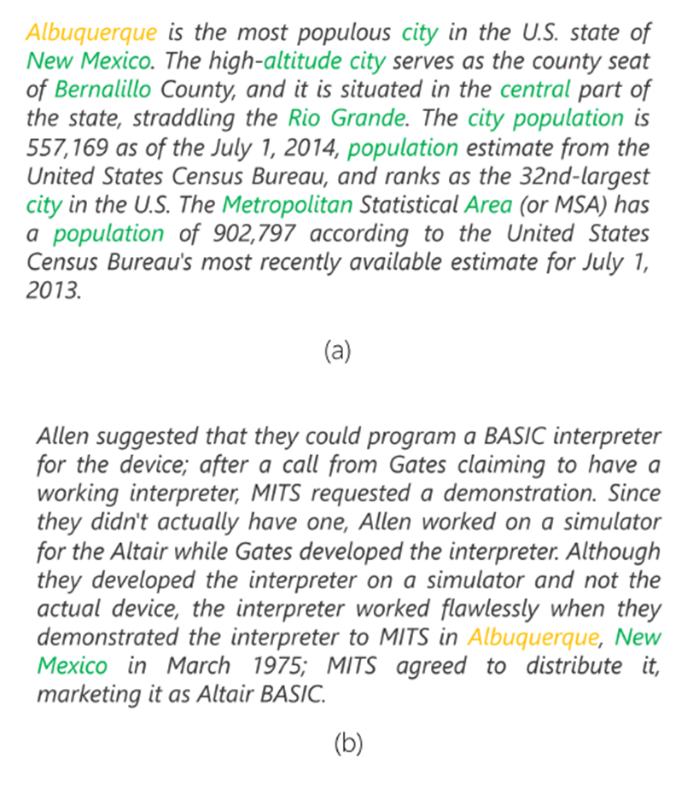
Desiderata
albuquerque
Term frequency
Term weighting
Term saturation
Document length
Term proximity
Term position
Vocabulary mismatch
Term aboutness
Passage about Albuquerque
Passage not about Albuquerque
By inspecting other terms in the document we may infer if the document is about the query term
Tip: consider expanding the query or matching the query terms with the document terms in a latent space

Slide 18
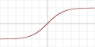

neural networks
Expected output
loss
Predicted output
Non-linearity
Chains of parameterized linear transforms (e.g., multiply weight, add bias) followed by non-linear functions (σ)
Popular choices for σ:
Parameters trained using backpropagation
E2E training over millions of samples in batched mode
Many choices of architecture and hyper-parameters
Linear transform
forward pass
backward pass
Tanh
ReLU
Non-linearity
Linear transform
Input

Slide 19
Visual motivation for hidden units
Input features |  |  |  | Label
surface | kerberos | book | library
1 | 0 | 1 | 0 | ✓
1 | 1 | 0 | 0 | ✗
0 | 1 | 0 | 1 | ✓
0 | 0 | 1 | 1 | ✗
Consider the following “toy” challenge for classifying tech queries:
Vocab: {surface, kerberos, book, library}
Labels:
“surface book”, “kerberos library” ✓
“kerberos surface”, “library book” ✗
can’t separate using a linear model!
+1
+1
H₁
H₂
But let’s consider a tiny neural network with one hidden layer…
-1
-1
+0.5
+0.5
-1
-1
+0.5
+0.5
surface
library
book
kerberos

Slide 20
Visual motivation for hidden units
Or more succinctly…
Input features |  |  |  | Hidden layer |  | Label
surface | kerberos | book | library | H₁ | H₂
1 | 0 | 1 | 0 | 1 | 0 | ✓
1 | 1 | 0 | 0 | 0 | 0 | ✗
0 | 1 | 0 | 1 | 0 | 1 | ✓
0 | 0 | 1 | 1 | 0 | 0 | ✗
Consider the following “toy” challenge for classifying tech queries:
Vocab: {surface, kerberos, book, library}
Labels:
“surface book”, “kerberos library” ✓
“kerberos surface”, “library book” ✗
can separate using a linear model!
+1
+1
H₁
H₂
But let’s consider a tiny neural network with one hidden layer…
-1
-1
+0.5
+0.5
-1
-1
+0.5
+0.5
surface
library
book
kerberos

Slide 21
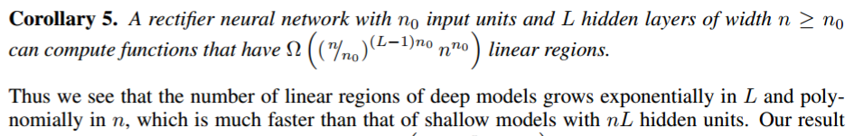
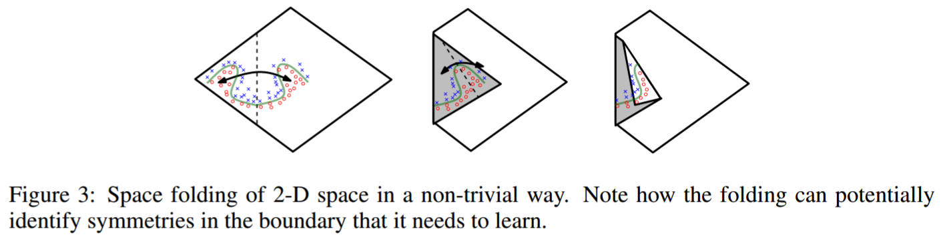
Why adding depth helps
Deeper networks can split the input space in many (non-independent) linear regions than shallow networks
Montúfar, Pascanu, Cho and Bengio. On the number of linear regions of deep neural networks NIPS 2014

Slide 22
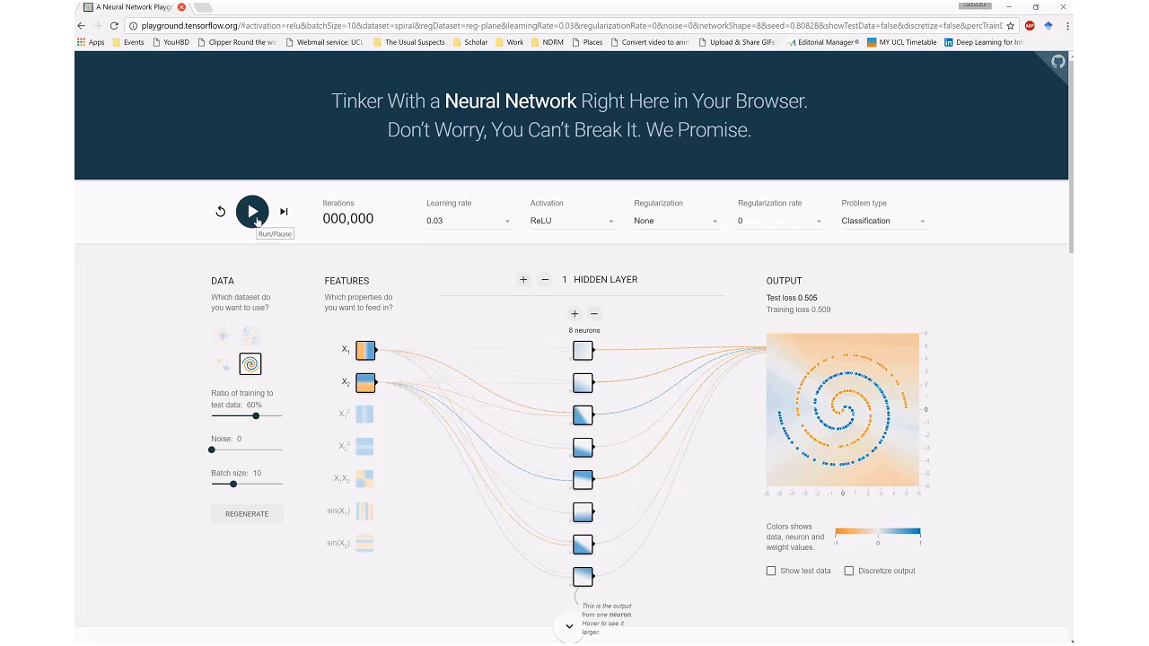
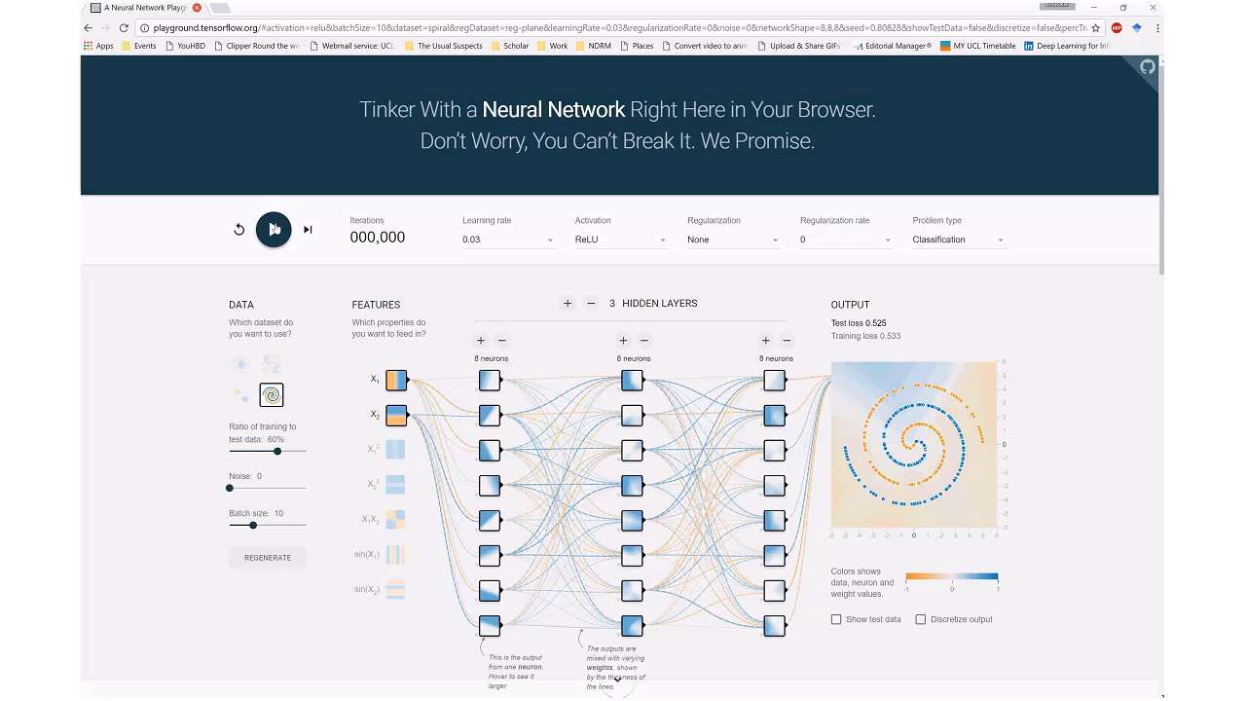
Why adding depth helps
http://playground.tensorflow.org

Slide 23

Questions?

Slide 24
Vector representations
(35 mins)

Slide 25
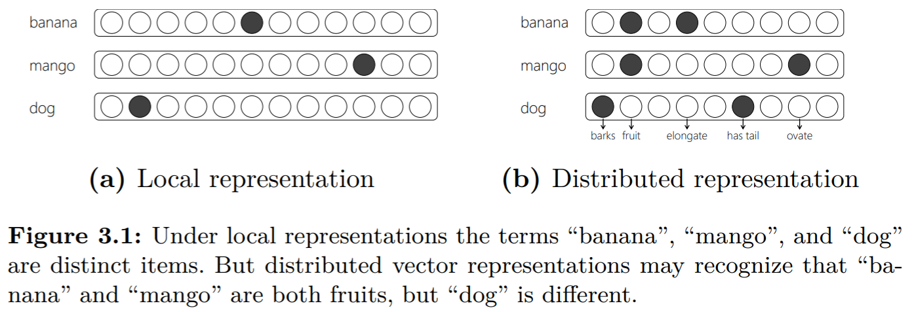
Types of vector representations
Local (or one-hot) representation
Every term in vocabulary T is represented by a binary vector of length |T|, where one position in the vector is set to one and the rest to zero
Distributed representation
Every term in vocabulary T is represented by a real-valued vector of length k. The vector can be sparse or dense. The vector dimensions may be observed (e.g., hand-crafted features) or latent (e.g., embedding dimensions).

Slide 26
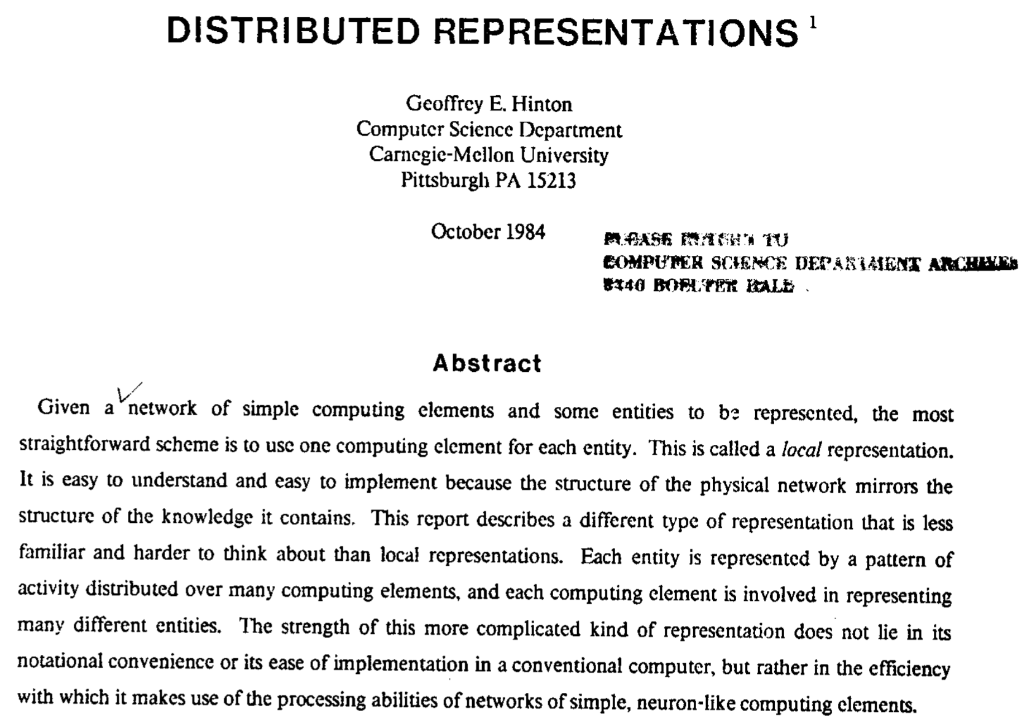
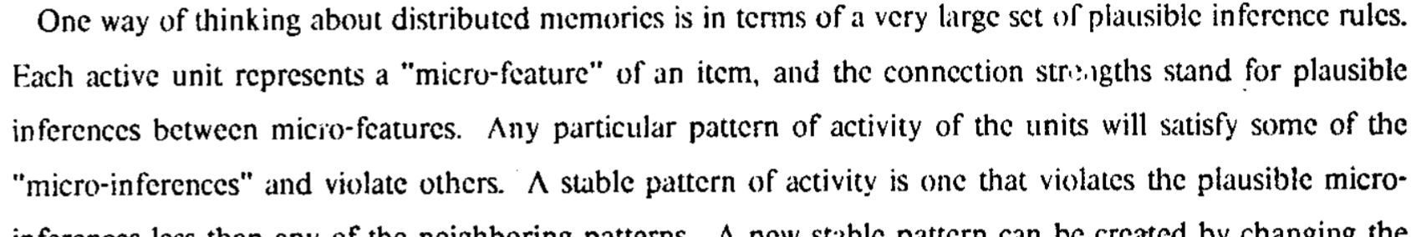
Hinton, Geoffrey E. Distributed representations. Technical Report CMU-CS-84-157, 1984
Notes:
Local representation
Distributed representation
One dimension for “banana” “banana” is a pattern
Brittle under noise More robust to noise
Precise Near “mango”, “pineapple”. (Nuanced)
Add vocab → Add dimensions Add vocab → Generate more vectors
K dimensions → K items K dimensions → 2^{k} “regions”

Slide 27
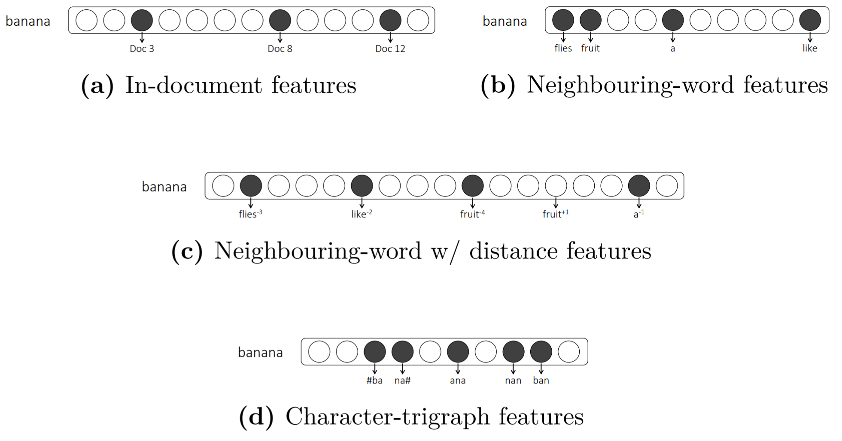
Observed (or explicit) Distributed representations
The choice of features is a key consideration
The distributional hypothesis states that terms that are used (or occur) in similar context tend to be semantically similar [Harris, 1954]
Firth [1957] famously purported this idea of distributional semantics by stating “a word is characterized by the company it keeps”.
Zellig S Harris. Distributional structure. Word, 10(2-3):146–162, 1954.
Firth, J. R. (1957). A synopsis of linguistic theory 1930–1955. In Studies in Linguistic Analysis, p. 11. Blackwell, Oxford.
Turney and Pantel. From frequency to meaning: Vector space models of semantics. Journal of artificial intelligence research 2010.

Slide 28
Minor note: Spot the difference!
Distributed representation
Distributional semantics
Vector representations of items as combinations of different features or dimensions (as opposed to one-hot)
Linguistic items with similar distributions (e.g. context words) have similar meanings
http://www.marekrei.com/blog/26-things-i-learned-in-the-deep-learning-summer-school/

Slide 29
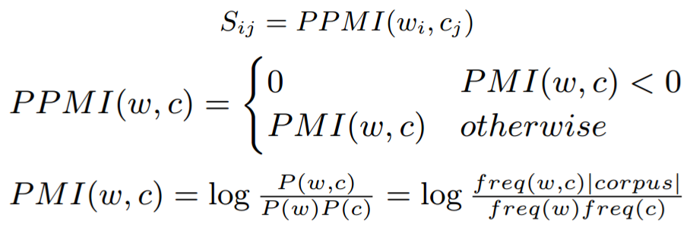
Example: Term-context vector space
 | C₀ | c₁ | c₂ | … | c_{j} | … | c_{|C|}
t₀
t₁
t₂
…
t_{i} |  |  |  |  | S_{ij}
…
t_{|T|}
T: vocabulary, C: set of contexts, S: sparse matrix |T| x |C|
(PPMI: Positive Pointwise Mutual Information)
t
t
t
t
t
t
t
t
t
Turney and Pantel. From frequency to meaning: Vector space models of semantics. Journal of artificial intelligence research 2010

Slide 30
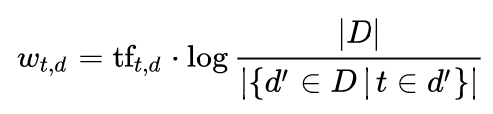
Example: Salton’s vector space
 | t₀ | t₁ | t₂ | … | t_{j} | … | t_{|T|}
d₀
d₁
d₂
…
d_{i} |  |  |  |  | S_{ij}
…
d_{|D|}
D: collection, T: vocabulary, S: sparse matrix |D| x |T|
S
idf
G. Salton , A. Wong , C. S. Yang, A vector space model for automatic indexing, Communications of the ACM, Nov. 1975

Slide 31
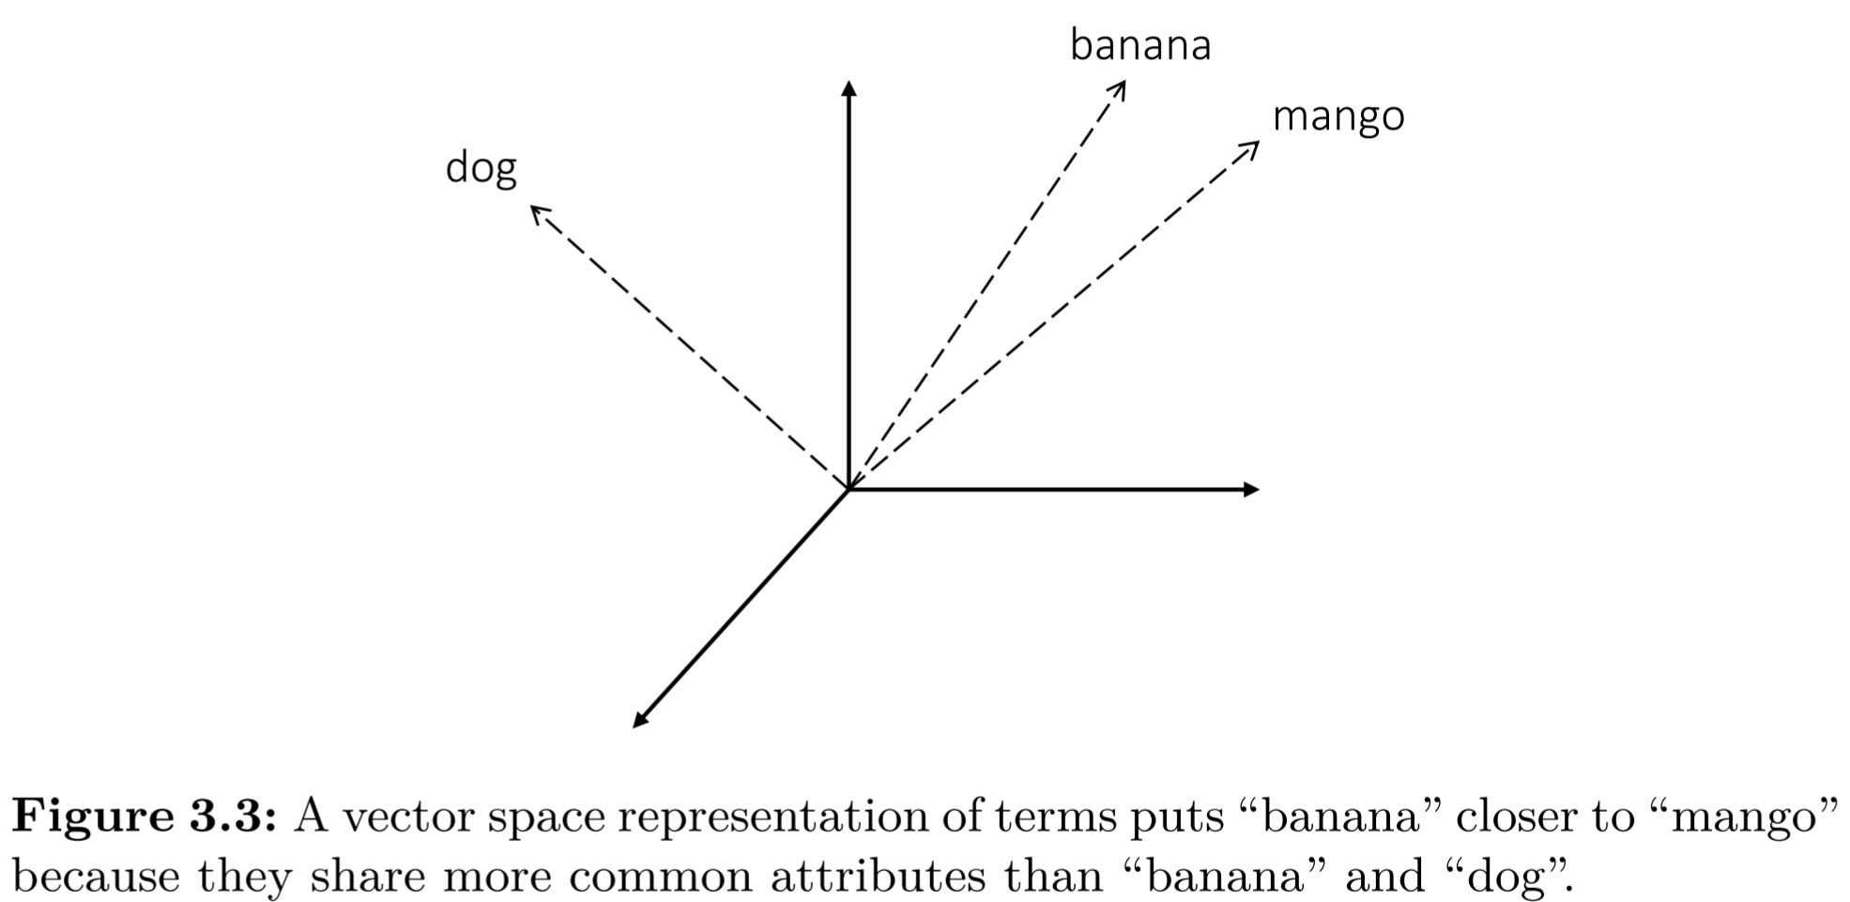
Notions of similarity
Two terms are similar if their feature vectors are close
But different feature spaces may capture different notions of similarity
Is Seattle more similar to…
Sydney (similar type)
or
Seahawks (similar topic)
Depends on your choice of features

Slide 32
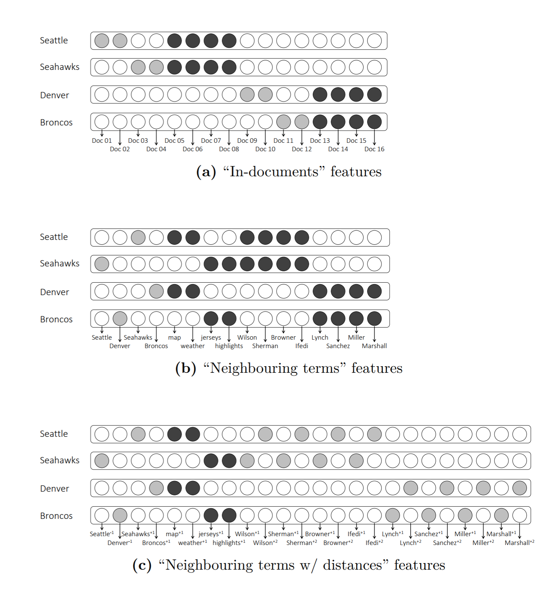
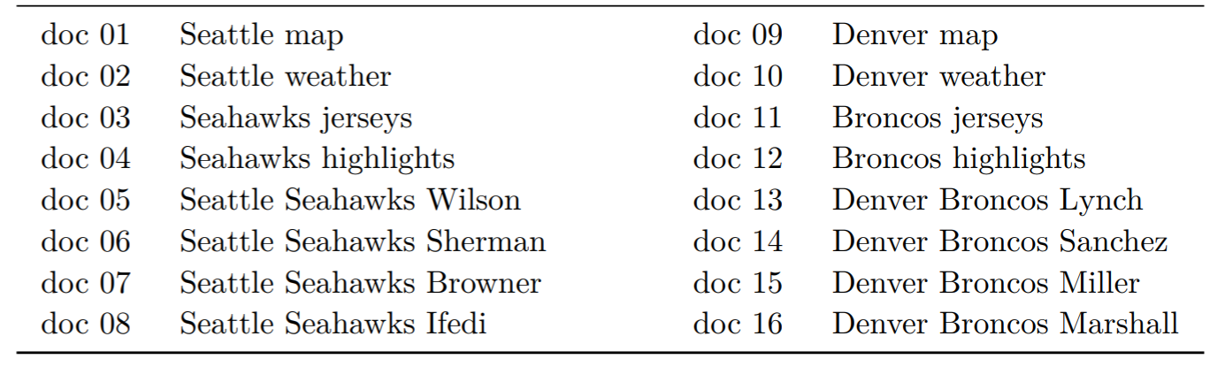
Notions of similarity
Consider the following toy corpus…
Now consider the different vector representations of terms you can derive from this corpus and how the items that are similar differ in these vector spaces

Slide 33
Notions of similarity
Topical or Syntagmatic similarity

Slide 34
Notions of similarity
Typical or Paradigmatic similarity

Slide 35
Notions of similarity
A mix of Topical and Typical similarity

Slide 36
Notions of similarity
Consider the following toy corpus…
Now consider the different vector representations of terms you can derive from this corpus and how the items that are similar differ in these vector spaces

Slide 37
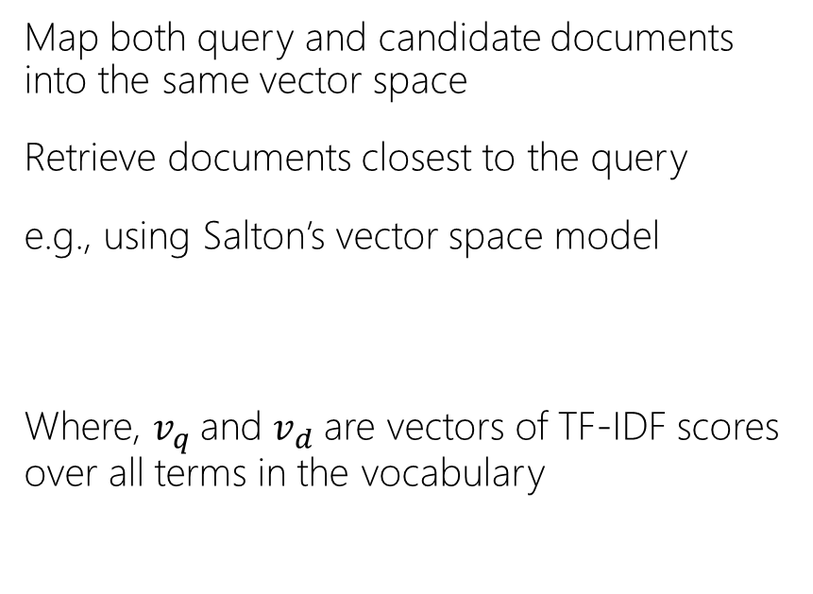
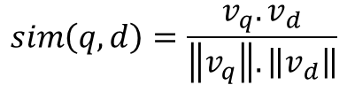
Retrieval using vector representations
Map both query and candidate documents into the same vector space
Retrieve documents closest to the query
e.g., using Salton’s vector space model
Where, $v_{q}$and $v_{d}$are vectors of TF-IDF scores over all terms in the vocabulary
$$sim\left(q, d\right)=\frac{v_{q}.v_{d}}{\left\|v_{q}\right\|.\left\|v_{d}\right\|}$$
G. Salton , A. Wong , C. S. Yang, A vector space model for automatic indexing, Communications of the ACM, Nov. 1975

Slide 38
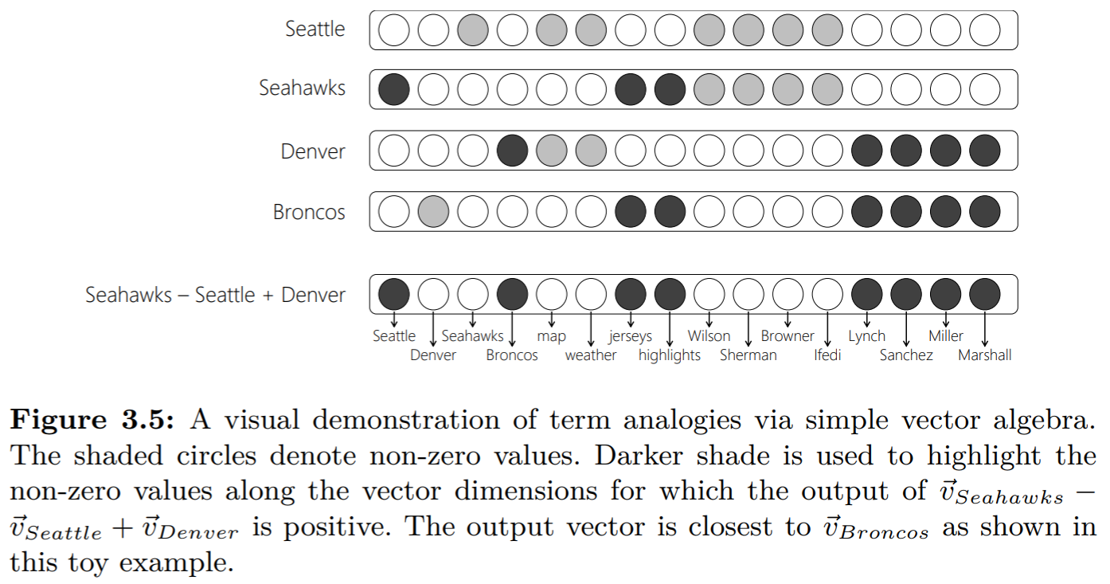
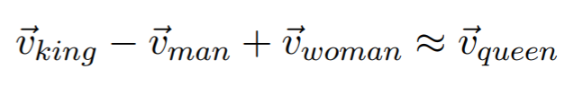
Regularities in observed feature spaces
Some feature spaces capture interesting linguistic regularities
e.g., simple vector algebra in the term-neighboring term space may be useful for word analogy tasks
Levy, Goldberg and Ramat-Gan. Linguistic Regularities in Sparse and Explicit Word Representations. CoNLL 2014

Slide 39
Embeddings
An embedding is a representation of items in a new space such that the properties of, and the relationships between, the items are preserved from the original representation.
Ian Goodfellow, Yoshua Bengio, and Aaron Courville. Deep learning. MIT Press, 2016.

Slide 40
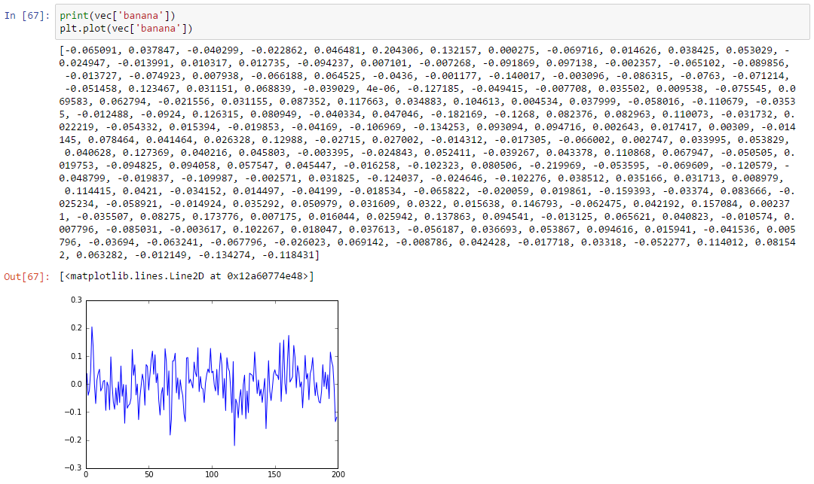
Embeddings
e.g., 200-dimensional term embedding for “banana”

Slide 41
Embeddings
Compared to observed feature spaces:
Embeddings typically have fewer dimensions
The space may have more disentangled principle components
The dimensions may be less interpretable
The latent representations may generalize better

Slide 42

What’s the advantage of latent vector spaces over observed features spaces?

Slide 43
Let’s take an IR example
Query: “Albuquerque”
In Salton’s vector space, both these passages are equidistant from the query “Albuquerque”
A latent feature representation may put the first passage closer to the query because of terms like “population” and “area”
Passage about Albuquerque
Passage not about Albuquerque

Slide 44
How to learn term embeddings?
Multiple approaches have been proposed for learning embeddings from <term, context, count> data
Popular approaches include matrix factorization or stochastic gradient descent (SGD)
 | C₀ | c₁ | c₂ | … | c_{j} | … | c_{|C|}
t₀
t₁
t₂
…
t_{i} |  |  |  |  | X_{ij}
…
t_{|T|}

Slide 45
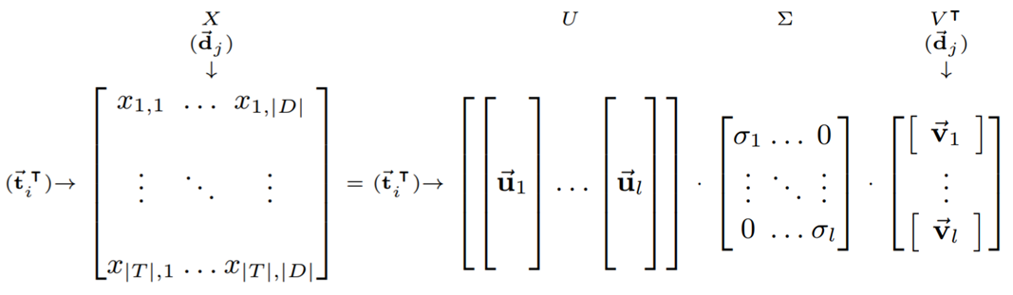
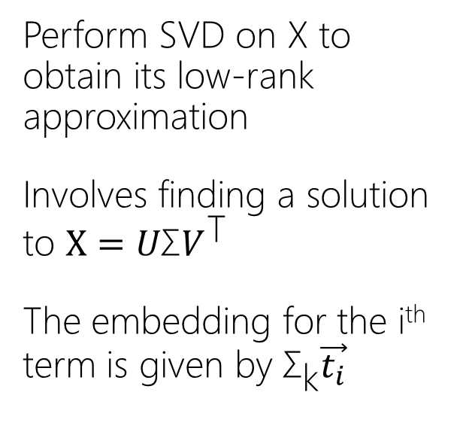
Latent Semantic Analysis (LSA)
Perform SVD on X to obtain its low-rank approximation
Involves finding a solution to $X=U\text{Σ}V^{\text{T}}$
The embedding for the i^{th} term is given by ${\text{Σ}}_{\text{k}}\vec{t_{i}}$
Scott C. Deerwester, Susan T Dumais, Thomas K. Landauer, George W. Furnas, and Richard A. Harshman. Indexing by latent semantic analysis. JASIS, 1990.

Slide 46
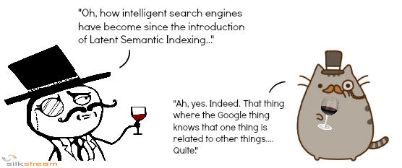
Latent Semantic Analysis (LSA)
Scott C. Deerwester, Susan T Dumais, Thomas K. Landauer, George W. Furnas, and Richard A. Harshman. Indexing by latent semantic analysis. JASIS, 1990.

Slide 47
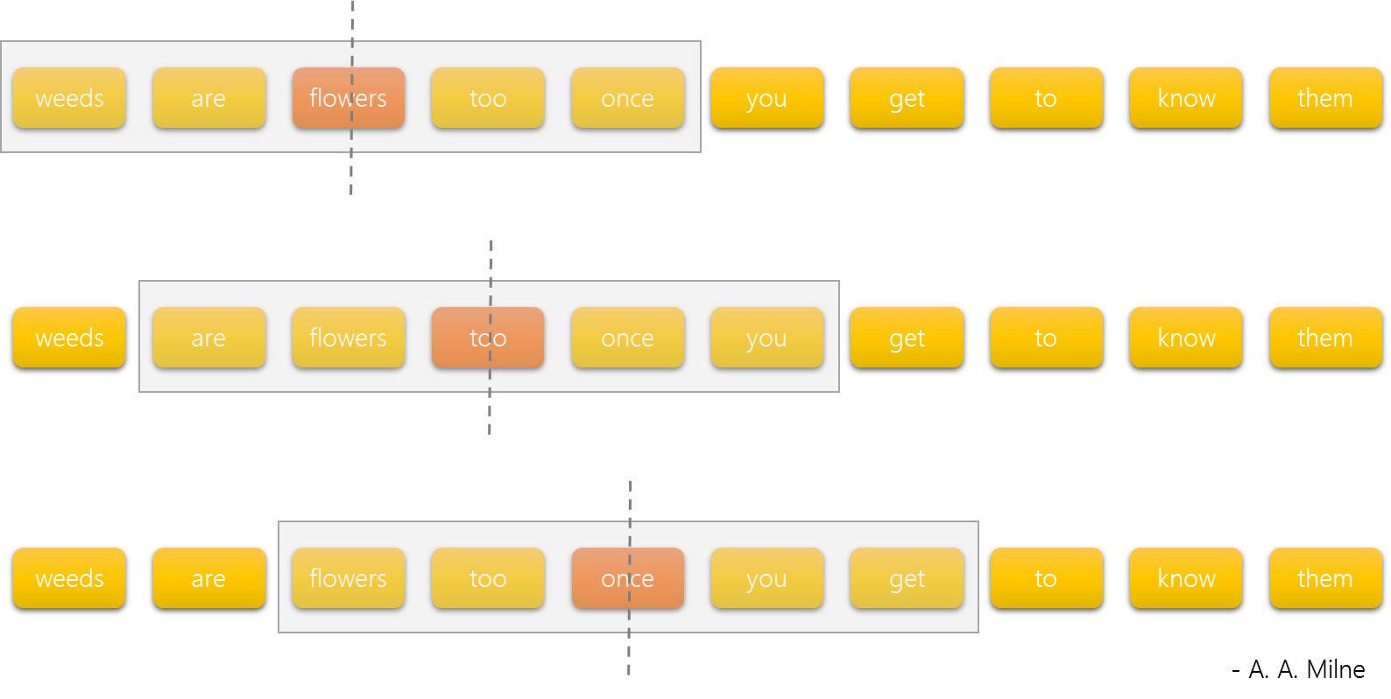
Word2vec
Goal: simple (shallow) neural model learning from billion words scale corpus
Predict middle word from neighbors within a fixed size context window
Two different architectures:
Skip-gram
CBOW
Tomas Mikolov, Ilya Sutskever, Kai Chen, Greg S Corrado, and Jeff Dean. Distributed representations of words and phrases and their compositionality. In NIPS, 2013.

Slide 48
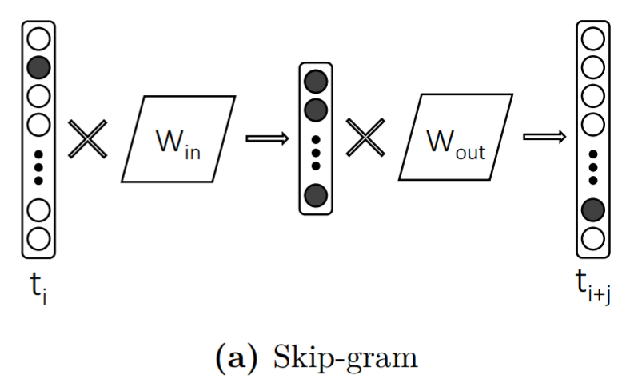
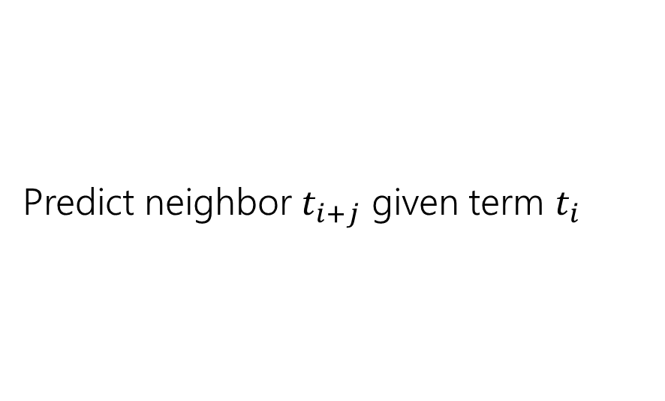
Skip-gram
Predict neighbor $t_{i+j}$ given term $t_{i}$

Slide 49
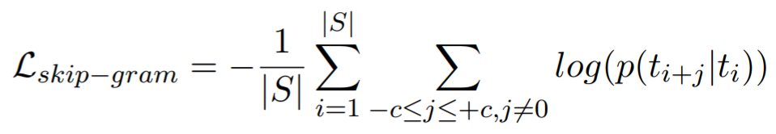
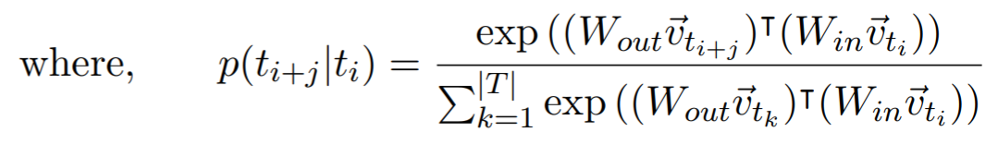
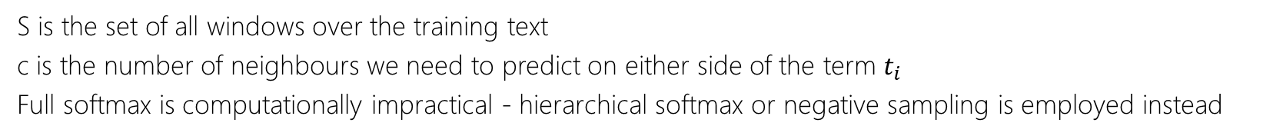
The Skip-gram loss
S is the set of all windows over the training text
c is the number of neighbours we need to predict on either side of the term $t_{i}$
Full softmax is computationally impractical - hierarchical softmax or negative sampling is employed instead

Slide 50
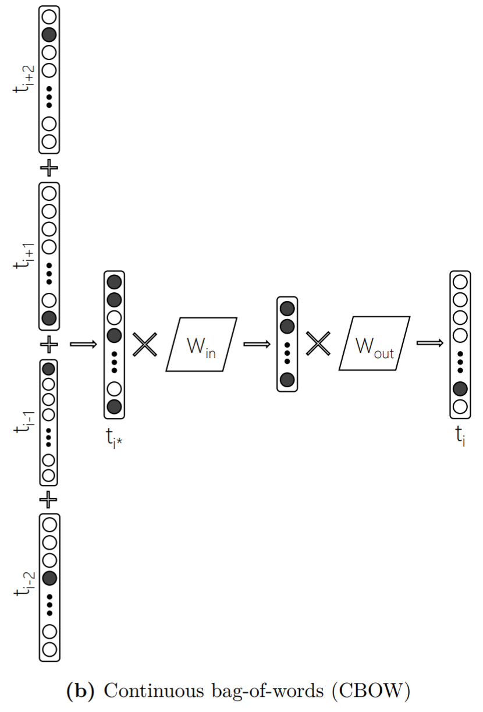
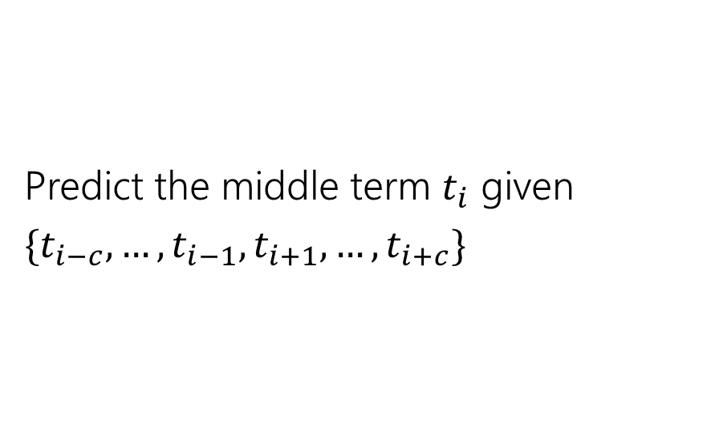
Continuous bag-of-words (CBOW)
Predict the middle term $t_{i}$ given $\{t_{i−c}, …,t_{i−1},t_{i+1},…,t_{i+c}\}$

Slide 51
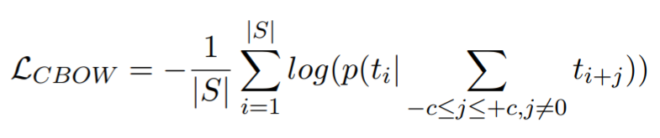
The CBOW loss
Note: from every window of text skip-gram generates 2 x c training samples whereas CBOW generates one – that’s why CBOW trains faster than skip-gram

Slide 52
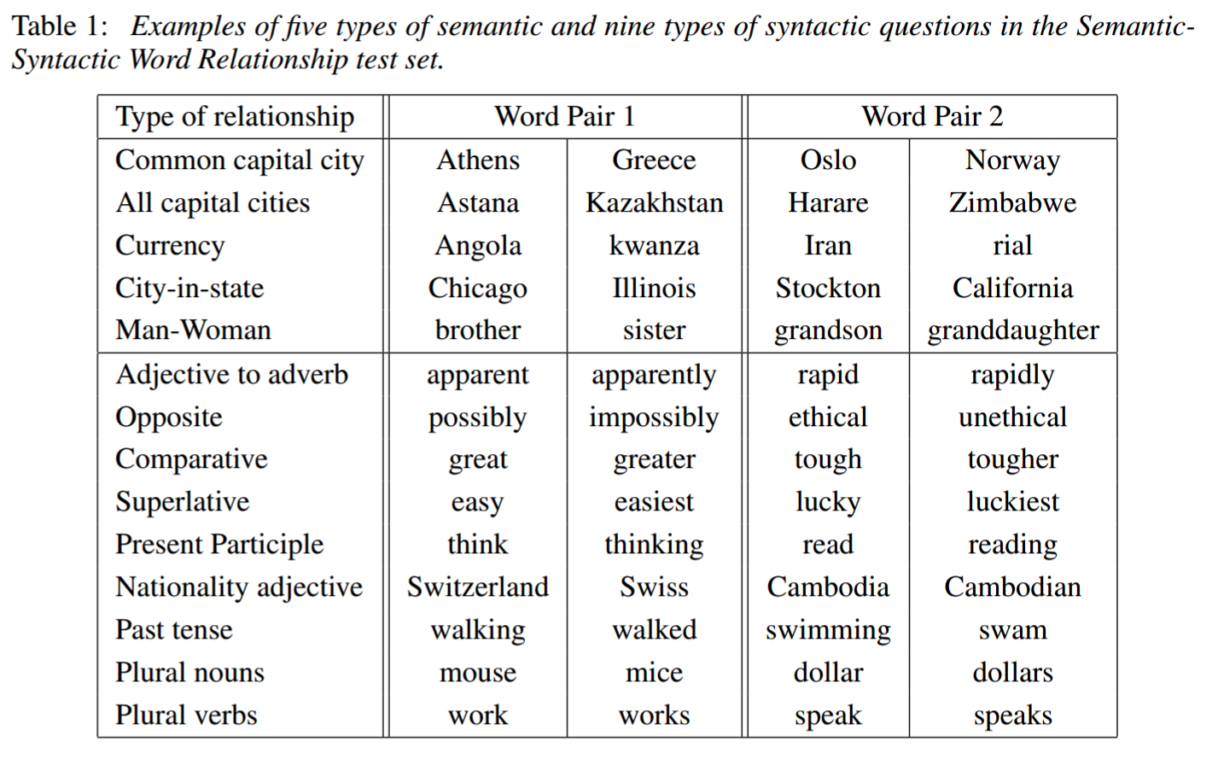
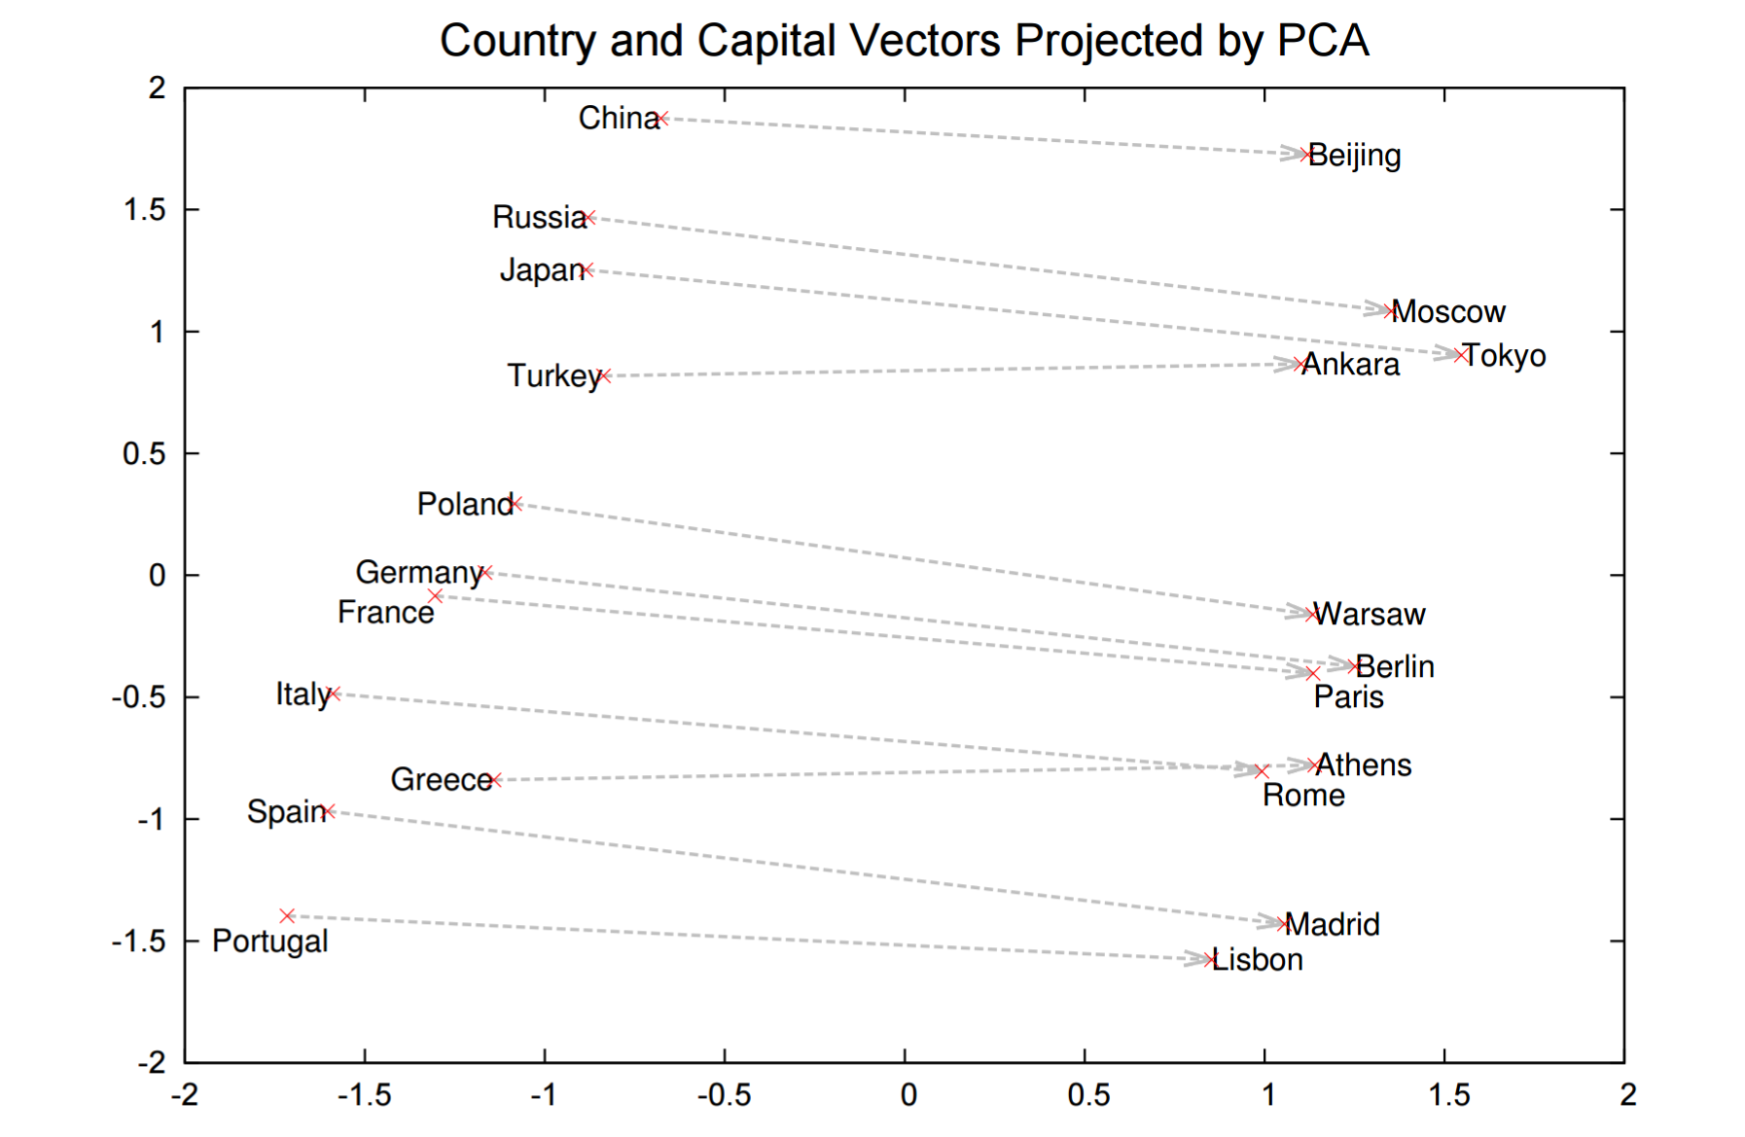
Word analogies with word2vec
W2v is popular for word analogy tasks
But remember the same relationships also exist in the observed feature space, as we saw earlier

Slide 53
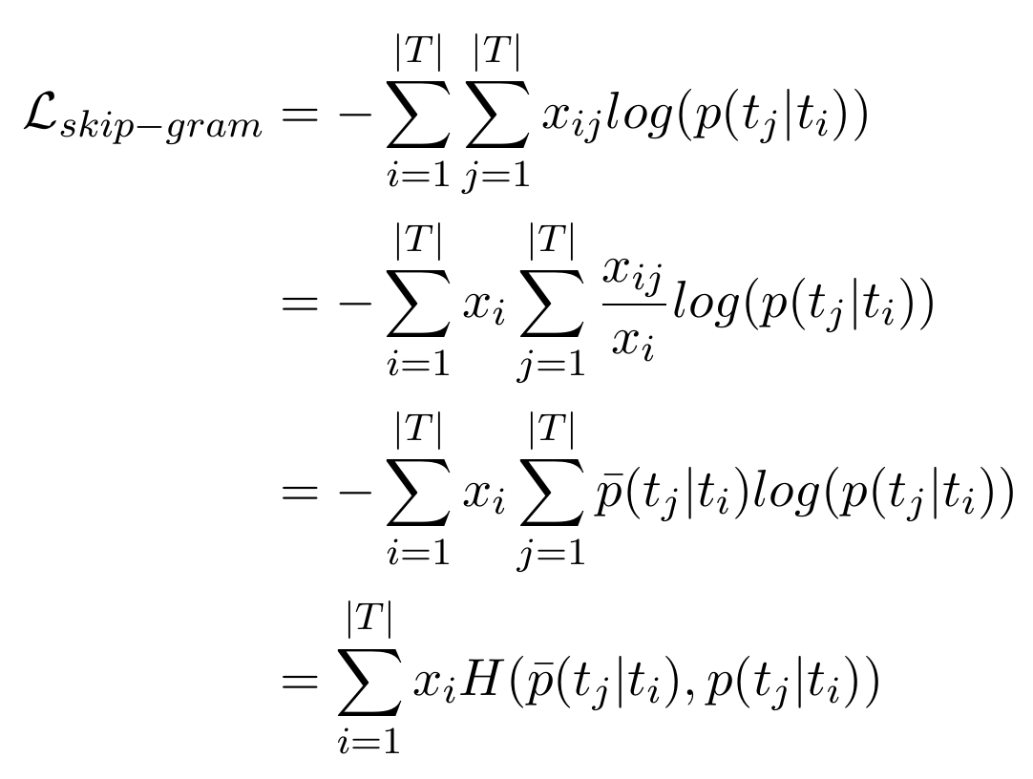
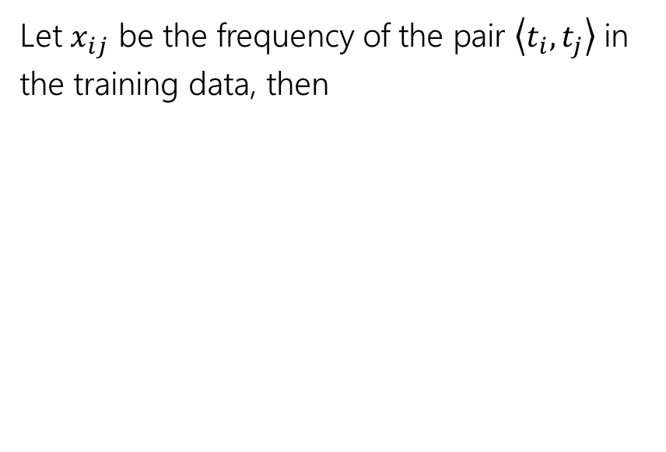
A Matrix Interpretation of word2vec
Let $x_{ij}$ be the frequency of the pair $\left\langle t_{i},t_{j}\right\rangle$ in the training data, then
 | t₀ | t₁ | t₂ | … | t_{j} | … | t_{|T|}
t₀
t₁
t₂
…
t_{i} |  |  |  |  | X_{ij}
…
t_{|T|}
actual co-occurrence probability
predicted co-occurrence probability
cross-entropy error

Slide 54
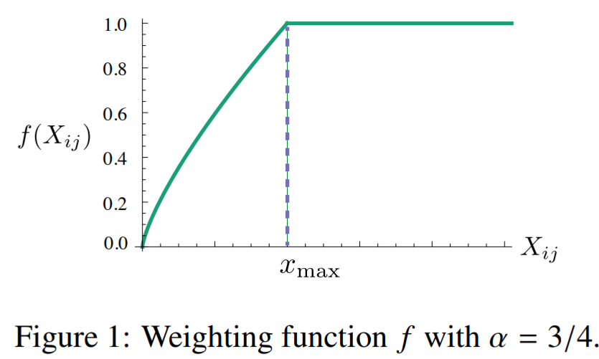
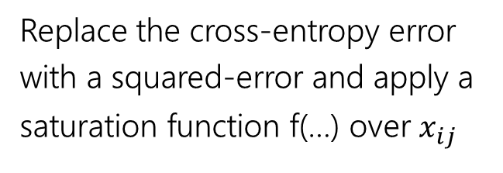
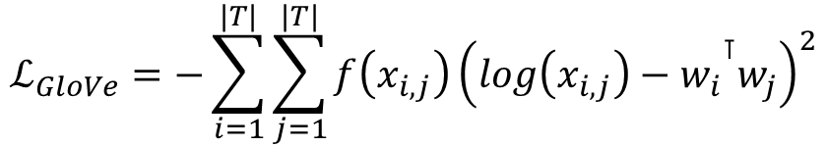
GloVe
Replace the cross-entropy error with a squared-error and apply a saturation function f(…) over $x_{ij}$
saturation function
$$ℒ_{GloVe}=−\sum_{i=1}^{|T|}{\sum_{j=1}^{|T|}{f\left(x_{i, j}\right){\left({{log\left(x_{i, j}\right)−w}_{i}}^{⊺}w_{j}\right)}^{2}}}$$
squared error
actual co-occurrence probability`
predicted co-occurrence probability
Jeffrey Pennington, Richard Socher, and Christopher D Manning. Glove: Global vectors for word representation. In EMNLP, 2014.

Slide 55
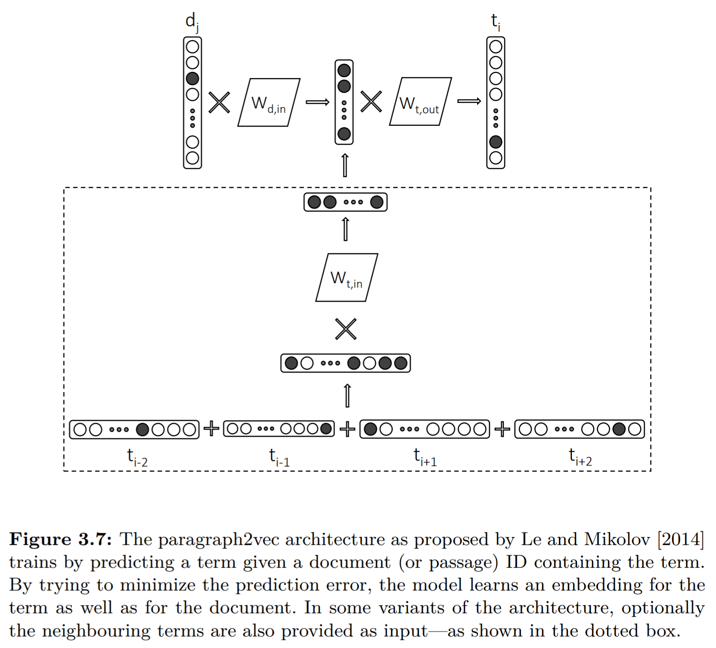
Paragraph2vec
W2v style model where context is document, not neighboring term
Quoc V Le and Tomas Mikolov. Distributed representations of sentences and documents. In ICML, 2014.

Slide 56
Recap: How to learn term embeddings?
Learn from <term, context, count> data
Choice of context (e.g., neighboring term or container document) defines what relationship you are modeling
Choice of learning algorithm (e.g., matrix factorization or SGD) defines how well you model the relationship
Choice of context and learning algorithm are independent – you can use matrix factorization with neighboring term context, or a w2v-style neural network with document context (e.g., paragraph2vec)

Slide 57

Questions?

Slide 58
Term embeddings for IR
(25 mins)

Slide 59
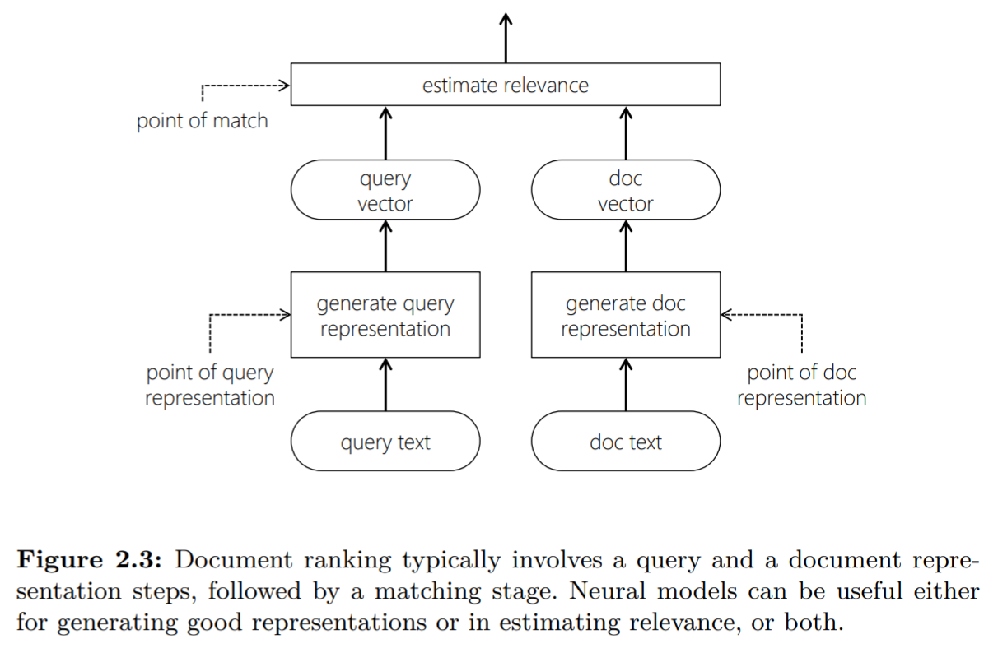
Recap: Retrieval using vector representations
Generate vector representation of query
Generate vector representation of document
Estimate relevance from q-d vectors

Slide 60
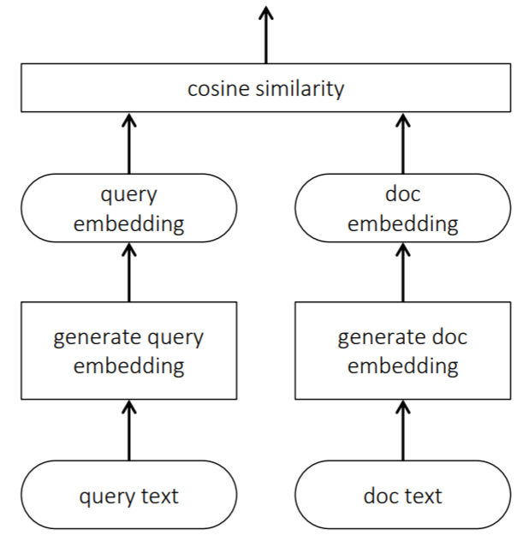
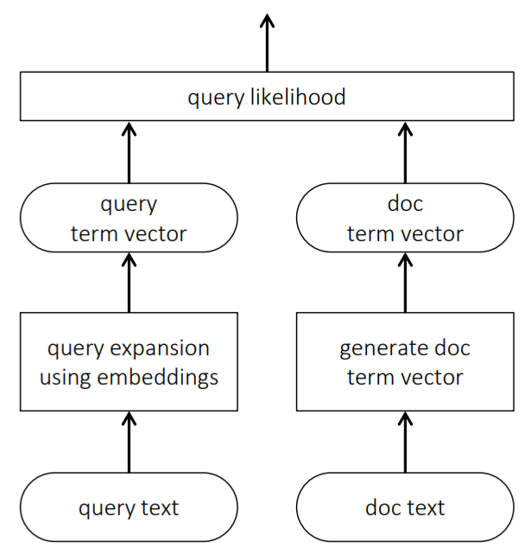
Popular approaches to incorporating term embeddings for matching
estimate relevance
estimate relevance
Compare query and document directly in the embedding space
Use embeddings to generate suitable query expansions

Slide 61
E.g.,
Generalized Language Model [Ganguly et al., 2015]
Neural Translation Language Model [Zuccon et al., 2015]
Average term embeddings [Le and Mikolov, 2014, Nalisnick et al., 2016, Zamani and Croft, 2016, and others]
Word mover’s distance [Kusner et al., 2015, Guo et al., 2016]
estimate relevance
Compare query and document directly in the embedding space

Slide 62
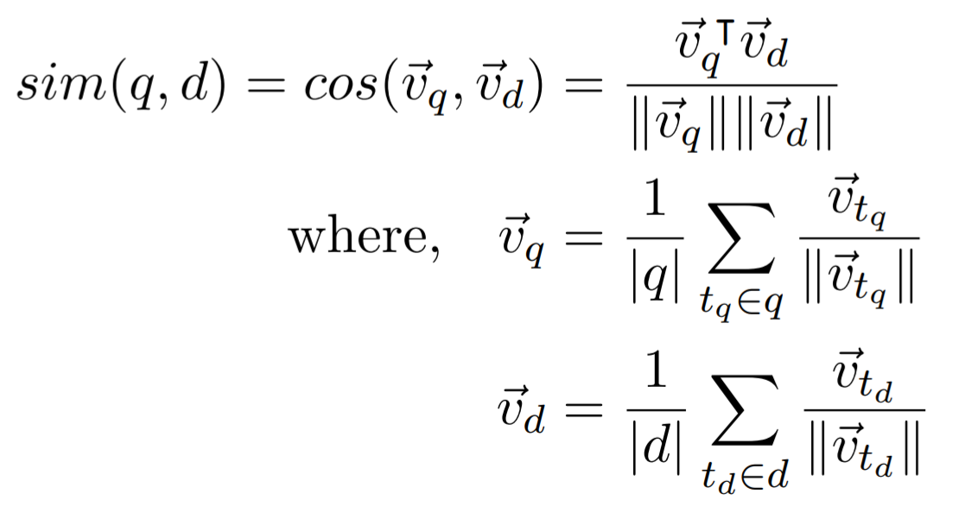
Average Term Embeddings
Q-D relevance estimated by computing cosine similarity between centroid of q and d term embeddings
Eric Nalisnick, Bhaskar Mitra, Nick Craswell, and Rich Caruana. Improving document ranking with dual word embeddings. In WWW, 2016.
Bhaskar Mitra, Eric Nalisnick, Nick Craswell, and Rich Caruana. A dual embedding space model for document ranking. arXiv preprint arXiv:1602.01137, 2016.

Slide 63
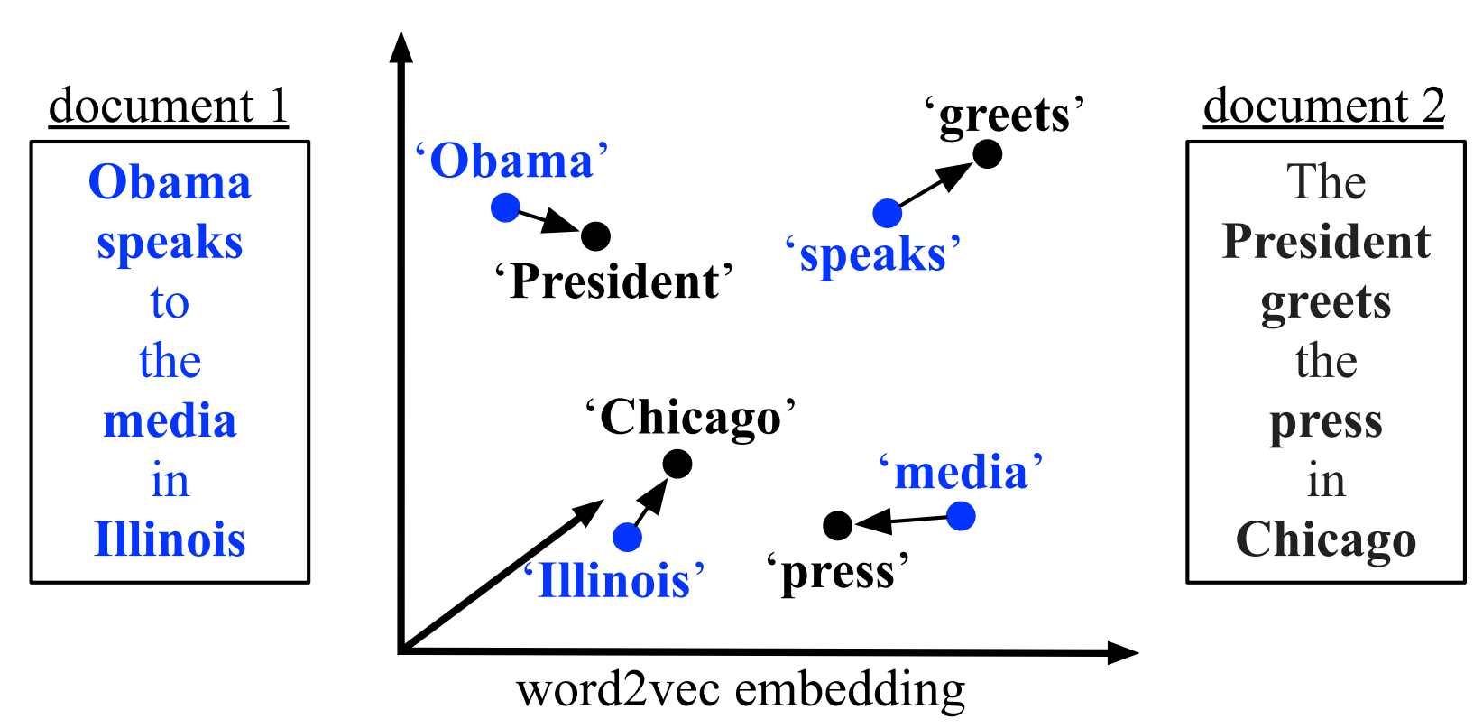
Word mover’s distance
Based on the Earth Mover’s Distance (EMD) [Rubner et al., 1998]
Originally proposed by Wan et al. [2005, 2007], but used WordNet and topic categories
Kusner et al. [2015] incorporated term embeddings
Adapted for q-d matching by Guo et al. [2016]
Yossi Rubner, Carlo Tomasi, and Leonidas J Guibas. A metric for distributions with applications to image databases. In CV, 1998.
Xiaojun Wan and Yuxin Peng. The earth mover’s distance as a semantic measure for document similarity. In CIKM, 2005.
Xiaojun Wan. A novel document similarity measure based on earth mover’s distance. Information Sciences, 2007.
Matt Kusner, Yu Sun, Nicholas Kolkin, and Kilian Weinberger. From word embeddings to document distances. In ICML, 2015.
Jiafeng Guo, Yixing Fan, Qingyao Ai, and W Bruce Croft. Semantic matching by non-linear word transportation for information retrieval. In CIKM, 2016.

Slide 64

But, wait… what term embeddings should we use?

Slide 65
Choice of term embeddings for document ranking
Query: “Albuquerque”
RECAP: for the query “Albuquerque” the relevant document may contain terms like “population” and “area”
Documents about “Santa Fe” not relevant for this query
“Albuquerque” ↔ “population” (Topically similar) ✓
“Albuquerque” ↔ “Santa Fe” (Typically similar) ✗
Standard LSA and para2vec capture topical similarity, whereas w2v and GloVe capture a mix of both Top/Typ-ical
Passage about Albuquerque
Passage not about Albuquerque

Slide 66
Dual embedding space model
What if I told you that everyone using word2vec is throwing half the model away?
Eric Nalisnick, Bhaskar Mitra, Nick Craswell, and Rich Caruana. Improving document ranking with dual word embeddings. In WWW, 2016.
Bhaskar Mitra, Eric Nalisnick, Nick Craswell, and Rich Caruana. A dual embedding space model for document ranking. arXiv preprint arXiv:1602.01137, 2016.

Slide 67
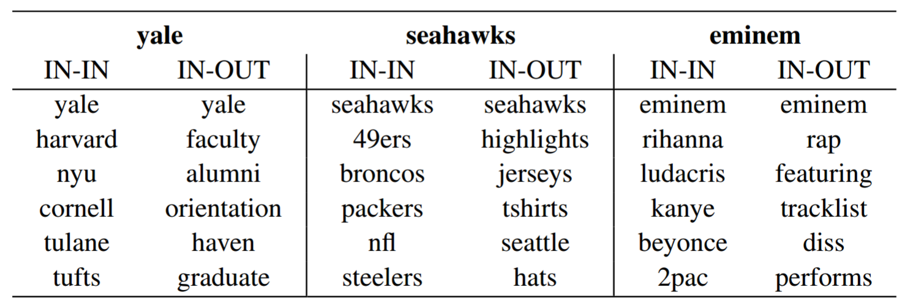
Dual embedding space model
IN-OUT captures a more Topical notion of similarity than IN-IN and OUT-OUT
Effect is exaggerated when embeddings are trained on short text (e.g., queries)
Eric Nalisnick, Bhaskar Mitra, Nick Craswell, and Rich Caruana. Improving document ranking with dual word embeddings. In WWW, 2016.
Bhaskar Mitra, Eric Nalisnick, Nick Craswell, and Rich Caruana. A dual embedding space model for document ranking. arXiv preprint arXiv:1602.01137, 2016.

Slide 68
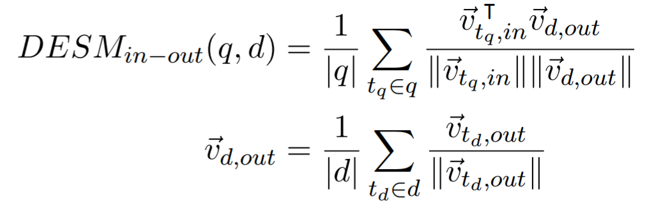
Dual embedding space model
Average term embeddings model, but use IN embeddings for query terms and OUT embeddings for document terms
Eric Nalisnick, Bhaskar Mitra, Nick Craswell, and Rich Caruana. Improving document ranking with dual word embeddings. In WWW, 2016.
Bhaskar Mitra, Eric Nalisnick, Nick Craswell, and Rich Caruana. A dual embedding space model for document ranking. arXiv preprint arXiv:1602.01137, 2016.

Slide 69

Dual embedding space model
Eric Nalisnick, Bhaskar Mitra, Nick Craswell, and Rich Caruana. Improving document ranking with dual word embeddings. In WWW, 2016.
Bhaskar Mitra, Eric Nalisnick, Nick Craswell, and Rich Caruana. A dual embedding space model for document ranking. arXiv preprint arXiv:1602.01137, 2016.

Slide 70
Challenge
IN+OUT Embeddings for 2.7M words trained on 600M+ Bing queries
http://bit.ly/DataDESM
Can you produce interesting tSNE visualizations that demonstrates the differences between IN-IN and IN-OUT term similarities?
Download

Slide 71
A tale of two queries
“pekarovic land company”
“what channel are the seahawks on today”
Hard to learn good representation for the rare term pekarovic
But easy to estimate relevance based on count of exact term matches of pekarovic in the document
Target document likely contains ESPN or sky sports instead of channel
The terms ESPN and channel can be compared in a term embedding space
Matching in the term space is necessary to handle rare terms. Matching in the latent embedding space can provide additional evidence of relevance. Best performance is often achieved by combining matching in both vector spaces.

Slide 72

Query: Cambridge (Font size is a function of term-term cosine similarity)
Besides the term “Cambridge”, other related terms (e.g., “university”, “town”, “population”, and “England”) contribute to the relevance of the passage
Bhaskar Mitra, Eric Nalisnick, Nick Craswell, and Rich Caruana. A dual embedding space model for document ranking. arXiv preprint arXiv:1602.01137, 2016.

Slide 73
Query: Cambridge (Font size is a function of term-term cosine similarity)
However, the same terms may also make a passage about Oxford look somewhat relevant to the query “Cambridge”
Bhaskar Mitra, Eric Nalisnick, Nick Craswell, and Rich Caruana. A dual embedding space model for document ranking. arXiv preprint arXiv:1602.01137, 2016.

Slide 74
Query: Cambridge (Font size is a function of term-term cosine similarity)
A passage about giraffes, however, obviously looks non-relevant in the embedding space…
Bhaskar Mitra, Eric Nalisnick, Nick Craswell, and Rich Caruana. A dual embedding space model for document ranking. arXiv preprint arXiv:1602.01137, 2016.

Slide 75
Query: Cambridge (Font size is a function of term-term cosine similarity)
But the embedding based matching model is more robust to the same passage when “giraffe” is replaced by “Cambridge”—a trick that would fool exact term based IR models. In a sense, the embedding based model ranks this passage low because Cambridge is not "an African even-toed ungulate mammal“.
Bhaskar Mitra, Eric Nalisnick, Nick Craswell, and Rich Caruana. A dual embedding space model for document ranking. arXiv preprint arXiv:1602.01137, 2016.

Slide 76
E.g.,
Generalized Language Model [Ganguly et al., 2015]
Neural Translation Language Model [Zuccon et al., 2015]
Average term embeddings [Le and Mikolov, 2014, Nalisnick et al., 2016, Zamani and Croft, 2016, and others]
Word mover’s distance []
estimate relevance
Compare query and document directly in the embedding space
Debasis Ganguly, Dwaipayan Roy, Mandar Mitra, and Gareth JF Jones. Word embedding based generalized language model for information retrieval. In SIGIR, 2015.
Guido Zuccon, Bevan Koopman, Peter Bruza, and Leif Azzopardi. Integrating and evaluating neural word embeddings in information retrieval. In ADCS, 2015.
Quoc V Le and Tomas Mikolov. Distributed representations of sentences and documents. In ICML, 2014.
Eric Nalisnick, Bhaskar Mitra, Nick Craswell, and Rich Caruana. Improving document ranking with dual word embeddings. In WWW, 2016.
Hamed Zamani and W Bruce Croft. Estimating embedding vectors for queries. In ICTIR, 2016.

Slide 77
Popular approaches to incorporating term embeddings for matching
estimate relevance
estimate relevance
Compare query and document directly in the embedding space
Use embeddings to generate suitable query expansions

Slide 78

Query expansion using term embeddings
estimate relevance
Find good expansion terms based on nearness in the embedding space
Better retrieval performance when combined with pseudo-relevance feedback (PRF) [Zamani and Croft, 2016] and if we learn query specific term embeddings [Diaz et al., 2016]
Use embeddings to generate suitable query expansions
Fernando Diaz, Bhaskar Mitra, and Nick Craswell. Query expansion with locally-trained word embeddings. In ACL, 2016.
Dwaipayan Roy, Debjyoti Paul, Mandar Mitra, and Utpal Garain. Using word embeddings for automatic query expansion. arXiv preprint arXiv:1606.07608, 2016.
Hamed Zamani and W Bruce Croft. Embedding-based query language models. In ICTIR, 2016.

Slide 79

Questions?

Slide 80

Break

Slide 81
Learning to Rank
(20 mins)

Slide 82

Learning to Rank (LTR)
L2R models represent a rankable item—e.g., a document—given some context—e.g., a user-issued query—as a numerical vector $\vec{x}∈ℝ^{n}$
The ranking model $f:\vec{x}→ℝ$ is trained to map the vector to a real-valued score such that relevant items are scored higher.
”... the task to automatically construct a ranking model using training data, such that the model can sort new objects according to their degrees of relevance, preference, or importance.”
- Liu [2009]
Tie-Yan Liu. Learning to rank for information retrieval. Foundation and Trends in Information Retrieval, 2009.

Slide 83

Approaches
Pointwise approach
Relevance label $y_{q,d}$ is a number—derived from binary or graded human judgments or implicit user feedback (e.g., CTR). Typically, a regression or classification model is trained to predict $y_{q,d}$ given ${\vec{x}}_{q,d}$.
Pairwise approach
Pairwise preference between documents for a query ($d_{i}≻d_{j}$ w.r.t. $q$) as label. Reduces to binary classification to predict more relevant document.
Listwise approach
Directly optimize for rank-based metric, such as NDCG—difficult because these metrics are often not differentiable w.r.t. model parameters.
Liu [2009] categorizes different LTR approaches based on training objectives:
Tie-Yan Liu. Learning to rank for information retrieval. Foundation and Trends in Information Retrieval, 2009.

Slide 84
Features
They can often be categorized as:
Query-independent or static features
e.g., incoming link count and document length
Query-dependent or dynamic features
e.g., BM25
Query-level features
e.g., query length
Traditional L2R models employ hand-crafted features that encode IR insights

Slide 85


Features
Tao Qin, Tie-Yan Liu, Jun Xu, and Hang Li. LETOR: A Benchmark Collection for Research on Learning to Rank for Information Retrieval, Information Retrieval Journal, 2010

Slide 86

Neural models for other tasks

Slide 87


The softmax function
In neural classification models, the softmax function is popularly used to normalize the neural network output scores across all the classes

Slide 88





Cross entropy
The cross entropy between two probability distributions $p$ and $q$ over a discrete set of events is given by,
If $p_{correct}=1$and $p_{i}=0$ for all other values of $i$ then,

Slide 89


Cross entropy with softmax loss
Cross entropy with softmax is a popular loss function for classification

Slide 90



Pointwise objectives
0
1
1
labels
Regression loss
Given $\left\langle q,d\right\rangle$ predict the value of $y_{q,d}$
e.g., square loss for binary or categorical labels,
where, $y_{q,d}$ is the one-hot representation [Fuhr, 1989] or the actual value [Cossock and Zhang, 2006] of the label
prediction
Norbert Fuhr. Optimum polynomial retrieval functions based on the probability ranking principle. ACM TOIS, 1989.
David Cossock and Tong Zhang. Subset ranking using regression. In COLT, 2006.

Slide 91


Pointwise objectives
0
1
labels
Classification loss
Given $\left\langle q,d\right\rangle$ predict the class $y_{q,d}$
e.g., cross-entropy with softmax over categorical labels $Y$ [Li et al., 2008],
where, $s_{y_{q,d}}$ is the model’s score for label $y_{q,d}$
prediction
Ping Li, Qiang Wu, and Christopher J Burges. Mcrank: Learning to rank using multiple classification and gradient boosting. In NIPS, 2008.

Slide 92



Pairwise objectives
Pairwise loss generally has the following form [Chen et al., 2009],
where, $φ$ can be,
Hinge function $φ\left(z\right)=max\left(0, 1−z\right)$ [Herbrich et al., 2000]
Exponential function $φ\left(z\right)=e^{−z}$ [Freund et al., 2003]
Logistic function $φ\left(z\right)=log\left(1+e^{−z}\right)$ [Burges et al., 2005]
Others…
Pairwise loss minimizes the average number of inversions in ranking—i.e., $d_{i}≻d_{j}$ w.r.t. $q$but $d_{j}$ is ranked higher than $d_{i}$
Given $\left\langle q,d_{i},d_{j}\right\rangle$, predict the more relevant document
For $\left\langle q,d_{i} \right\rangle$ and $\left\langle q, d_{j}\right\rangle$,
Feature vectors: ${\vec{x}}_{i}$ and ${\vec{x}}_{j}$
Model scores: $s_{i}=f\left({\vec{x}}_{i}\right)$ and $s_{j}=f\left({\vec{x}}_{j}\right)$
Wei Chen, Tie-Yan Liu, Yanyan Lan, Zhi-Ming Ma, and Hang Li. Ranking measures and loss functions in learning to rank. In NIPS, 2009.
Ralf Herbrich, Thore Graepel, and Klaus Obermayer. Large margin rank boundaries for ordinal regression. 2000.
Yoav Freund, Raj Iyer, Robert E Schapire, and Yoram Singer. An efficient boosting algorithm for combining preferences. In JMLR, 2003.
Chris Burges, Tal Shaked, Erin Renshaw, Ari Lazier, Matt Deeds, Nicole Hamilton, and Greg Hullender. Learning to rank using gradient descent. In ICML, 2005.

Slide 93

Pairwise objectives
0
1
pairwise preference
RankNet loss
Pairwise loss function proposed by Burges et al. [2005]—an industry favourite [Burges, 2015]
Predicted probabilities: $p_{ij}=p\left(s_{i}>s_{j}\right)≡\frac{e^{γ.s_{i}^{}}}{e^{γ.s_{i}^{}}+e^{γ.s_{j}^{}}}=\frac{1}{1+e^{−γ.\left(s_{i}−s_{j}\right) }}$
Desired probabilities: ${\overline{p}}_{ij}=1$ and ${\overline{p}}_{ji}=0$
Computing cross-entropy between $p$ and $\overline{p}$
$$ℒ_{RankNet}=−{\overline{p}}_{ij}.log\left(p_{ij}\right)−{\overline{p}}_{ji}.log\left(p_{ji}\right)=−log\left(p_{ij}\right)=log\left(1+e^{−γ.\left(s_{i}−s_{j}\right) }\right)$$
score
Chris Burges, Tal Shaked, Erin Renshaw, Ari Lazier, Matt Deeds, Nicole Hamilton, and Greg Hullender. Learning to rank using gradient descent. In ICML, 2005.
Chris Burges. RankNet: A ranking retrospective. https://www.microsoft.com/en-us/research/blog/ranknet-a-ranking-retrospective/. 2015.

Slide 94

A generalized cross-entropy loss
An alternative loss function assumes a single relevant document $d^{+}$ and compares it against the full collection $D$
Predicted probabilities: $p\left(d^{+}|q\right)=\frac{e^{γ.s\left(q,d^{+}\right) }}{\sum_{d∈D}{e^{γ.s\left(q,d \right) }}}$
The cross-entropy loss is then given by,
$$ℒ_{CE}\left(q,d^{+},D\right)=−log\left(p\left(d^{+}|q\right)\right)=−log\left(\frac{e^{γ.s\left(q,d^{+}\right) }}{\sum_{d∈D}{e^{γ.s\left(q,d \right) }}}\right)$$
Computing the softmax over the full collection is prohibitively expensive—LTR models typically consider few negative candidates [Huang et al., 2013, Shen et al., 2014, Mitra et al., 2017]
Po-Sen Huang, Xiaodong He, Jianfeng Gao, Li Deng, Alex Acero, and Larry Heck. Learning deep structured semantic models for web search using clickthrough data. In CIKM, 2013.
Yelong Shen, Xiaodong He, Jianfeng Gao, Li Deng, and Gregoire Mesnil. A latent semantic model with convolutional-pooling structure for information retrieval. In CIKM, 2014.
Bhaskar Mitra, Fernando Diaz, and Nick Craswell. Learning to match using local and distributed representations of text for web search. In WWW, 2017.

Slide 95

Listwise objectives
Blue: relevant Gray: non-relevant
NDCG and ERR higher for left but pairwise errors less for right
Due to strong position-based discounting in IR measures, errors at higher ranks are much more problematic than at lower ranks
But listwise metrics are non-continuous and non-differentiable
[Burges, 2010]
Christopher JC Burges. From ranknet to lambdarank to lambdamart: An overview. Learning, 2010.

Slide 96

Listwise objectives
Burges et al. [2006] make two observations:
To train a model we don’t need the costs themselves, only the gradients (of the costs w.r.t model scores)
It is desired that the gradient be bigger for pairs of documents that produces a bigger impact in NDCG by swapping positions
LambdaRank loss
Multiply actual gradients with the change in NDCG by swapping the rank positions of the two documents
Christopher JC Burges, Robert Ragno, and Quoc Viet Le. Learning to rank with nonsmooth cost functions. In NIPS, 2006.

Slide 97

Listwise objectives
ListNet loss
Cao et al. [2007] propose to compute the probability distribution over all possible permutations based on model score and ground-truth labels. The loss is then given by the K-L divergence between these two distributions.
This is computationally very costly, computing permutations of only the top-K items makes it slightly less prohibitive.
ListMLE loss
Xia et al. [2008] propose to compute the probability of the ideal permutation based on the ground truth. However, with categorical labels more than one permutation is possible.
According to the Luce model [Luce, 2005], given four items $\left\{d_{1},d_{2},d_{3},d_{4}\right\}$ the probability of observing a particular rank-order, say $\left[d_{2},d_{1},d_{4},d_{3}\right]$, is given by:
where, $π$ is a particular permutation and $φ$ is a transformation (e.g., linear, exponential, or sigmoid) over the score $s_{i}$ corresponding to item $d_{i}$
R Duncan Luce. Individual choice behavior. 1959.
Zhe Cao, Tao Qin, Tie-Yan Liu, Ming-Feng Tsai, and Hang Li. Learning to rank: from pairwise approach to listwise approach. In ICML, 2007.
Fen Xia, Tie-Yan Liu, Jue Wang, Wensheng Zhang, and Hang Li. Listwise approach to learning to rank: theory and algorithm. In ICML, 2008.

Slide 98

Questions?

Slide 99

So far, we have discussed:
Unsupervised learning of text representations using shallow neural networks and employing them in traditional IR models
Supervised learning of neural models (shallow or deep) for the ranking task using hand-crafted features
In the last session, we will discuss:
Supervised training of deep neural networks—with richer structures—for IR tasks based on raw representations of query and document text

Slide 100
Deep neural networks
(25 mins)

Slide 101

Different modalities of input text representation

Slide 102
Different modalities of input text representation

Slide 103
Different modalities of input text representation

Slide 104
Different modalities of input text representation

Slide 105

Shift-invariant neural operations
Detecting a pattern in one part of the input space is similar to detecting it in another
Leverage redundancy by moving a window over the whole input space and then aggregate
On each instance of the window a kernel—also known as a filter or a cell—is applied
Different aggregation strategies lead to different architectures

Slide 106


Convolution
Move the window over the input space each time applying the same cell over the window
A typical cell operation can be,
$$h=σ\left(WX+b\right)$$
Full Input | [words x in_channels]
Cell Input | [window x in_channels]
Cell Output | [1 x out_channels]
Full Output | [1 + (words – window) / stride x out_channels]

Slide 107

Pooling
Move the window over the input space each time applying an aggregate function over each dimension in within the window
$$h_{j}=\max_{i∈win}\left(X_{i,j}\right) or h_{j}={avg}_{i∈win}\left(X_{i,j}\right)$$
max -pooling
average -pooling
Full Input | [words x channels]
Cell Input | [window x channels]
Cell Output | [1 x channels]
Full Output | [1 + (words – window) / stride x channels]

Slide 108

Convolution w/ Global Pooling
Stacking a global pooling layer on top of a convolutional layer is a common strategy for generating a fixed length embedding for a variable length text
Full Input | [words x in_channels]
Full Output | [1 x out_channels]

Slide 109


Recurrent neural network
Similar to a convolution layer but additional dependency on previous hidden state
A simple cell operation shown below but others like LSTM and GRUs are more popular in practice,
$$h_{i}=σ\left(WX_{i}+Uh_{i−1}+b\right)$$
Full Input | [words x in_channels]
Cell Input | [window x in_channels] + [1 x out_channels]
Cell Output | [1 x out_channels]
Full Output | [1 x out_channels]

Slide 110


Recursive NN or Tree-RNN
Shared weights among all the levels of the tree
Cell can be an LSTM or as simple as
$$h=σ\left(WX+b\right)$$
Full Input | [words x channels]
Cell Input | [window x channels]
Cell Output | [1 x channels]
Full Output | [1 x channels]

Slide 111




Autoencoder
Unsupervised models trained to minimize reconstruction errors
Information Bottleneck method (Tishby et al., 1999)
The bottleneck layer $\vec{x}$ captures “minimal sufficient statistics” of $\vec{v}$ and is a compressed representation of the same

Slide 112


Siamese network
Supervised model trained on $\left\langle q,d_{1},d_{2}\right\rangle$ where $d_{1}$is relevant to q, but $d_{2}$ is non-relevant
Logistic loss is popularly used—think RankNet where $sim\left({\vec{v}}_{q},{\vec{v}}_{d}\right)$ is the model score
Typically both left and right models share similar architectures, but may also choose to share the learnable parameters

Slide 113

Computation Networks
The “Lego” approach to specifying DNN architectures
Library of computation nodes, each node defines logic for:
Forward pass: compute output given input
Backward pass: compute gradient of loss w.r.t. inputs, given gradient of loss w.r.t. outputs
Parameter gradient: compute gradient of loss w.r.t. parameters, given gradient of loss w.r.t. outputs
Chain nodes to create bigger and more complex networks

Slide 114



Really Deep Neural Networks
(Larsson et al., 2016)
(He et al., 2015)
(Szegedy et al., 2014)

Slide 115

Toolkits
A diverse set of options to choose from!
Figure from https://towardsdatascience.com/battle-of-the-deep-learning-frameworks-part-i-cff0e3841750

Slide 116

Questions?

Slide 117
Deep neural networks for IR
(30 mins)

Slide 118


Semantic hashing
Document autoencoder minimizing reconstruction error
Input: word counts (vocab size = 2K)
Output: binary vector
Stacked RBMs w/ layer-by-layer pre-training followed by E2E tuning
Ruslan Salakhutdinov and Geoffrey Hinton. Semantic hashing. In IJAR, 2009.

Slide 119


Deep semantic similarity model (DSSM)
Siamese network trained E2E on query and document title pairs
Relevance is estimated by cosine similarity between query and document embeddings
Input: character trigraph counts (bag of words assumption)
Minimizes cross-entropy loss against randomly sampled negative documents
Po-Sen Huang, Xiaodong He, Jianfeng Gao, Li Deng, Alex Acero, and Larry Heck. Learning deep structured semantic models for web search using clickthrough data. In CIKM, 2013.

Slide 120


Convolutional DSSM (CDSSM)
Replace bag-of-words assumption by concatenating term vectors in a sequence on the input
Convolution followed by global max-pooling
Yelong Shen, Xiaodong He, Jianfeng Gao, Li Deng, and Gregoire Mesnil. A latent semantic model with convolutional-pooling structure for information retrieval. In CIKM, 2014.

Slide 121

Remember…
…how different embedding spaces capture different notions of similarity?

Slide 122
DSSM trained on different types of data
Trained on pairs of… | Sample training data | Useful for? | Paper
Query and document titles | <“things to do in seattle”, “seattle tourist attractions”> | Document ranking | (Shen et al., 2014) https://dl.acm.org/citation...
Query prefix and suffix | <“things to do in”, “seattle”> | Query auto-completion | (Mitra and Craswell, 2015) https://dl.acm.org/citation...
Consecutive queries in user sessions | <“things to do in seattle”, “space needle”> | Next query suggestion | (Mitra, 2015) https://dl.acm.org/citation...
Each model captures a different notion of similarity (or regularity) in the learnt embedding space
Yelong Shen, Xiaodong He, Jianfeng Gao, Li Deng, and Gregoire Mesnil. A latent semantic model with convolutional-pooling structure for information retrieval. In CIKM, 2014.
Bhaskar Mitra and Nick Craswell. Query auto-completion for rare prefixes. In CIKM, 2015.
Bhaskar Mitra. Exploring session context using distributed representations of queries and reformulations. In SIGIR, 2015.

Slide 123

Different regularities in different embedding spaces
Nearest neighbors for “seattle” and “taylor swift” based on two DSSM models – one trained on query-document pairs and the other trained on query prefix-suffix pairs
Yelong Shen, Xiaodong He, Jianfeng Gao, Li Deng, and Gregoire Mesnil. A latent semantic model with convolutional-pooling structure for information retrieval. In CIKM, 2014.
Bhaskar Mitra and Nick Craswell. Query auto-completion for rare prefixes. In CIKM, 2015.

Slide 124


Different regularities in different embedding spaces
Groups of similar search intent transitions from a query log
The DSSM trained on session query pairs can capture regularities in the query space (similar to word2vec for terms)
Bhaskar Mitra. Exploring session context using distributed representations of queries and reformulations. In SIGIR, 2015.

Slide 125

DSSM trained on Session query pairs Allows for analogies over short text!
Bhaskar Mitra. Exploring session context using distributed representations of queries and reformulations. In SIGIR, 2015.

Slide 126


Interaction-based networks
Typically a document is relevant if some part of the document contains information relevant to the query
Interaction matrix $X$—where $x_{ij}$ is obtained by comparing the i^{th} window over query terms with the j^{th} window over the document terms—captures evidence of relevance from different parts of the document
Additional neural network layers can inspect the interaction matrix and aggregate the evidence to estimate overall relevance
Zhengdong Lu and Hang Li. A deep architecture for matching short texts. In NIPS, 2013.

Slide 127

Remember…
…the important of incorporating exact term matches as well as matches in the latent space for estimating relevance?

Slide 128

Lexical and semantic matching networks
Mitra et al. [2016] argue that both lexical and semantic matching is important for document ranking
Duet model is a linear combination of two DNNs—focusing on lexical and semantic matching, respectively—jointly trained on labelled data
Bhaskar Mitra, Fernando Diaz, and Nick Craswell. Learning to match using local and distributed representations of text for web search. In WWW, 2017.

Slide 129


Lexical and semantic matching networks
Lexical sub-model operates over input matrix $X$
$$x_{i,j}=\left\{\begin{aligned}1, if t_{q,i}=t_{d,j} \\ 0, otherwise\end{aligned}\right.$$
In relevant documents,
Many matches, typically in clusters
Matches localized early in document
Matches for all query terms
In-order (phrasal) matches
Bhaskar Mitra, Fernando Diaz, and Nick Craswell. Learning to match using local and distributed representations of text for web search. In WWW, 2017.

Slide 130


Lexical and semantic matching networks
Convolve using window of size $n_{d}×1$
Each window instance compares a query term w/ whole document
Bhaskar Mitra, Fernando Diaz, and Nick Craswell. Learning to match using local and distributed representations of text for web search. In WWW, 2017.

Slide 131

Lexical and semantic matching networks
Semantic sub-model matches in the latent embedding space
Match query with moving windows over document
Learn text embeddings specifically for the task
Bhaskar Mitra, Fernando Diaz, and Nick Craswell. Learning to match using local and distributed representations of text for web search. In WWW, 2017.

Slide 132


Big vs. small data regimes
Big data seems to be more crucial for models that focus on good representation learning for text
Partial supervision strategies (e.g., unsupervised pre-training of word embeddings) can be effective but may be leaving the bigger gains on the table
Which IR models are similar?
Clustering based on query level retrieval performance.
Learning to train on unlabeled data may be key to making progress on neural ad-hoc retrieval
Bhaskar Mitra, Fernando Diaz, and Nick Craswell. Learning to match using local and distributed representations of text for web search. In WWW, 2017.

Slide 133
Challenge
Duet implementation on CNTK (python)
http://bit.ly/CodeDUET
Can you evaluate the duet model on a popular community question-answering task?
Get the code

Slide 134













Many other neural architectures
(Hui et al., 2017)
(Pang et al., 2017)
(Denil et al., 2014)
(Severyn and Moschitti, 2015)
(Jaech et al., 2017)
(Kalchbrenner et al., 2014)
(Dehghani et al., 2017)
(Kim, 2014)
(Guo et al., 2016)
(Zhao et al., 2015)
(Palangi et al., 2015)
(Hu et al., 2014)
(Tai et al., 2015)

Slide 135




But Web documents are more than just body text…
URL
body
clicked query
title
incoming anchor text

Slide 136

Ranking Documents with multiple fields
Learn different embedding space for each document field
Different fields may match different aspects of the query—learn different query embeddings for matching against different fields
Represent per field match by a vector, not a score
Field level dropout during training can regularize against over-dependency on any individual field
Hamed Zamani, Bhaskar Mitra, Xia Song, Nick Craswell, and Saurabh Tiwary. Neural ranking models with multiple document fields. In WSDM, 2018.

Slide 137




Neural models for Emerging IR tasks
Conversational response retrieval (Zhou et al., 2016, Yan et al., 2016)
Multimodal retrieval (Ma et al., 2015)
Proactive retrieval (Luukkonen et al., 2016)
Knowledge-based IR (Nguyen et al., 2016)

Slide 138

Questions?

Slide 139




Deep Learning Lab sessions @ 1445
Thank You

Slide 140



THE UNREASONABLE EFFECTIVENESS OF SIMPLE LTR BASED APPROACHES

Slide 141
Neural models for other tasks

Slide 142



Challenges in IR [slide 1/3]
Vocabulary mismatch
Q: How many people live in Sydney?
Sydney’s population is 4.9 million [relevant, but missing ‘people’ and ‘live’]
Hundreds of people queueing for live music in Sydney [irrelevant, and matching ‘people’ and ‘live’]
Need to interpret words based on context (e.g., temporal)
Vocab mismatch:
Worse for short texts
Still an issue for long texts
query:
“uk prime minister”
Today
Recent
In older (1990s) TREC data

Slide 143

Challenges in IR [slide 2/3]
Need to learn Q-D relationship that generalizes to the tail
Unseen Q
Unseen D
Unseen information needs
Unseen vocabulary

Slide 144

Challenges in IR [slide 3/3]
Query and document vary in length
Models must handle variable length input
Relevant docs have irrelevant sections

Slide 145


Generalized Language Model
Traditional language modeling based IR approach may estimate q-d relevance as follows,
where, $p\left(t_{q}|d\right)$ is the probability of generating term $t_{q}$from document $d$

Slide 146

Generalized Language Model
Traditional language modeling based IR approach may estimate q-d relevance as follows,
$\hat{p}\left(t_{q}|d\right)$ and $\hat{p}\left(t_{q}|D\right)$ are the probabilities of randomly sampling term $t_{q}$from document $d$ and the full collection $D$, respectively
$\hat{p}\left(t_{q}|D\right)$has a smoothing effect on the $p\left(t_{q}|d\right)$ estimation

Slide 147
Generalized Language Model
GLM includes additional smoothing based on term similarity in the embedding space
Debasis Ganguly, Dwaipayan Roy, Mandar Mitra, and Gareth JF Jones. Word embedding based generalized language model for information retrieval. In SIGIR, 2015.

Slide 148
Generalized Language Model
GLM includes additional smoothing based on term similarity in the embedding space
Debasis Ganguly, Dwaipayan Roy, Mandar Mitra, and Gareth JF Jones. Word embedding based generalized language model for information retrieval. In SIGIR, 2015.

Slide 149
Generalized Language Model
GLM includes additional smoothing based on term similarity in the embedding space
Debasis Ganguly, Dwaipayan Roy, Mandar Mitra, and Gareth JF Jones. Word embedding based generalized language model for information retrieval. In SIGIR, 2015.

Slide 150

Generalized Language Model
GLM includes additional smoothing based on term similarity in the embedding space
Probability of generating the term from the document based on similarity in the embedding space
Probability of generating the term from the full collection based on similarity in the embedding space
Debasis Ganguly, Dwaipayan Roy, Mandar Mitra, and Gareth JF Jones. Word embedding based generalized language model for information retrieval. In SIGIR, 2015.

Slide 151




Neural translation language model
TLM estimates $p\left(t_{q}|t_{d}\right)$ from q-d paired data similar to statistical machine translation
NTLM uses term-term similarity in the embedding space to estimate $p\left(t_{q}|t_{d}\right)$
Translation Language Model:
Neural Translation Language Model:
Guido Zuccon, Bevan Koopman, Peter Bruza, and Leif Azzopardi. Integrating and evaluating neural word embeddings in information retrieval. In ADCS, 2015.

